Slide 1
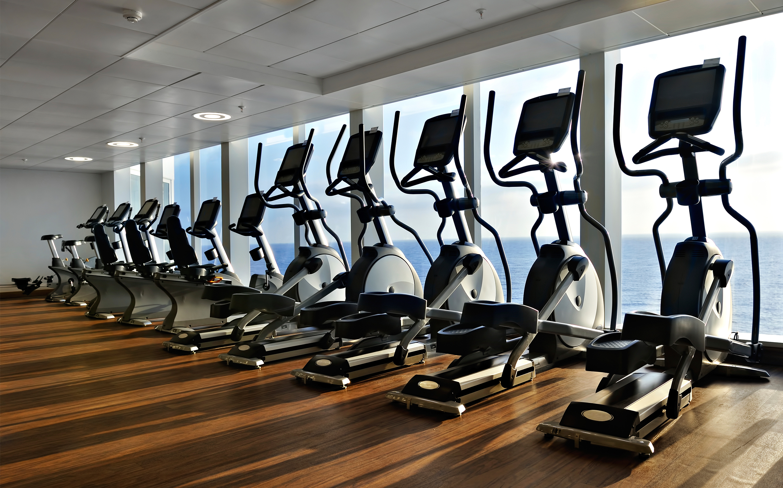
The “Perks” of Working for UW
Sponsored by the Committee on Academic Staff Initiatives
CASI, compiled by Erin McBride
A brief guide to the benefits, incentives and “extras” you can enjoy by simply being part of the UW community.
Sept. 26, 2019

Slide 2
Categories of Perks working.wisc.edu
Categories of Perks:
1. Human Resources
Employee Benefits Packages, Payroll, Plans and Insurance
Childcare and Family Resources
Employee Assistance and Workplace Relations
2. Professional Development
Learning and Talent Development
Courses and Certificate Programs (WI School of Business)
Professional Development Grants

Slide 3
Categories of PERKS working.wisc.edu
3. On Campus
Parking and Transportation
Dining
Wellness, Outdoor Activities, Natural Areas
Arts and Entertainment
Personal Discounts
4. Employee Toolkit
− Information Technology/DoIT
− Tools and services (BOX, Qualtrics, PI Portal, Shop@UW)
− Event Management and Catering

Slide 4
1. Human Resources
Pay
Payroll services
Tax forms
Benefits
Benefits services & package options, benefits directory
Personal benefits summaries
Retirement resources
Savings Plan options
Time Off
Leave benefits, Disability and Medical Leave https://oed.wisc.edu/
Legal holidays

Slide 5
1. Human Resources
Childcare and Family Resources
Office of Child Care and Family Resources (OCCFR)
https://occfr.wisc.edu/index.html
Early education, child care, family support services
OCCFR has contracted with 6 additional licensed and accredited high quality child care programs for UW Families
https://occfr.wisc.edu/campus-child-care-centers/uw-child-care-network/
Childcare Grants and financial assistance for UW Faculty and Staff is available
https://occfr.wisc.edu/financial-assistance/uw-madison-faculty-and-staff/

Slide 6
1. Human Resources
Employee Assistance and Workplace Relations
Employee Assistance Office confidential counseling https://hr.wisc.edu/employee-assistance-office/
NEW: LIfeMatters (24/7 access to professional counselors for personal or work related concerns)
https://hr.wisc.edu/employee-assistance-office/lifematters/
Office of Workforce Relations workplace issue resolution https://hr.wisc.edu/about/workforce-relations/
Hostile and Intimidating Behavior resources for advice, consultation, support on campus
https://hr.wisc.edu/hib/
Cultural and Linguistic Services translation and interpretation services and communication training
https://www.talent.wisc.edu/

Slide 7
1. Human Resources
For more information, please see:
Office of Human Resources:
http://hr.wisc.edu
Working at UW Human Resources:
https://working.wisc.edu/human-resources/

Slide 8
2. Professional Development
Learning and Talent Development
Office of Talent Management sponsors and manages over 3,000 learning events
Online Training (Lynda.com) resource library of training videos and tutorials on software and more
Courses and Certificate Programs
Wisconsin School of Business and College of Engineering offer Certificate programs, online courses and other professional development opportunities
IRB Training, HIPPA Certification
Professional Development Grants
Financial support for professional development for Academic Staff and University Staff https://acstaff.wisc.edu/professional-development/grants

Slide 9
2. Professional Development
For more information, please see:
Office of Talent Management:
http://talent.wisc.edu
Working at UW Professional Development:
https://working.wisc.edu/professional-development/

Slide 10
3. On Campus
Parking and Transportation
Parking Permits Explained https://transportation.wisc.edu/permits/
See the Law School’s Unit Transportation Coordinator (Adam Bushcott) for timelines and questions
Commuting Resources
Wisconsin Van Pool https://transportation.wisc.edu/vanpool/
Emergency Ride Home https://transportation.wisc.edu/commuter-solutions/emergency-ride-home/
See printed vouchers

Slide 11
3. On Campus
Parking and Transportation
Discounted Employee Bus Pass https://transportation.wisc.edu/bus/employee-bus-pass-program/
Download the Bus Tracker App
$48 per year, apply online or in person
Bike Share: Madison Bcycle https://madison.bcycle.com/home
Download the “Bcycle App”
$30 per year membership fee with a UW email account
promo code: WISCFACULTY

Slide 12
3. On Campus
Dining
UW–Madison employees receive a 5% discount by using a WisCard to purchase food at all UW Dining Options
Faculty and Staff Meal Plan: Pay $29.99 and your WisCard gets you 20% off all year at dining halls (must sign up in person at Gordon Dining Hall, lower level)
Dining Options: Six UW Housing dining halls, Memorial Union, Union South, Babcock Dairy, Wisconsin Institutes for Discovery, Badger Alley Bistro
https://www.housing.wisc.edu/dining/locations/
New this year: “Ticket to Take Out Program” (reusable containers)

Slide 13
3. On Campus
Wellness, Outdoor Activities
Rec Sports for workout facilities, classes, clubs intramurals and events
Outdoor UW includes activities, sports, equipment rentals and WI Hoofers Clubs
UWell initiatives to advance health and well-being of the UW Madison community
Safety Center-Child safety products and injury prevention education
SafeWalk-Free walking companionship service available to all students, faculty, staff, and UW visitors. https://transportation.wisc.edu/safewalk/

Slide 14
3. On Campus
Arts and Entertainment
Wisconsin Union
events, classes, exhibits, movies
https://union.wisc.edu/events-and-activities/
Arts Institute events
https://arts.wisc.edu
art, dance, design, film, literature, music, theatre
Athletics
https://uwbadgers.com/index.aspx
Nature Areas
Lakeshore Nature Preserve
Allen Centennial Gardens
UW Arboretum

Slide 15
3. On Campus
Lakeshore Nature Preserve, Lake Mendota South Shore
https://lakeshorepreserve.wisc.edu

Slide 16
3. On Campus
Allen Centennial Gardens, 620 Babcock Drive, Madison
https://arboretum.wisc.edu

Slide 17
3. On Campus
UW Arboretum, 1207 Seminole Highway, Madison
https://arboretum.wisc.edu

Slide 18
3. On Campus
Personal Discounts
− Cell Phones-provider plan discount for UW Employees https://kb.wisc.edu/page.php?id=25058
− Personal Car rental discounts at National and Enterprise (must reserve through Concur)
https://www.concursolutions.com/nui/signin
− Personal Lodging/Hotel Discounts https://www.bussvc.wisc.edu/acct/policy/travel/lodging.html
− Sherwin-Williams Paint discounts (ask at stores)
− LifeSuite Program travel assistance, legal services, beneficiary financial counseling and legacy planning

Slide 19
3. On Campus
− SWAP (Surplus With A Purpose)
https://swap.wisc.edu
− Many insurance providers offer discounts or reimbursements to UW employees on the State health plan for
gym memberships
sports clubs, classes
complementary medicine
athletic shoes
CSA food shares (and more)
− Technology/Software discounts (See 4. Employee Toolkit)

Slide 20
3. On Campus
For more information, please see:
Discounts:
https://working.wisc.edu/discounts/
Working at UW On Campus:
https://working.wisc.edu/on-campus/

Slide 21
4. Employee Toolkit
Where to go for assistance:
Information Technology/DoIT Tools and services
− DoIT Help Desk (264-4357)
− BOX
− Qualtrics
− PI Portal
− Shop@UW
Quick Links to IT Discounts:
Microsoft Office-free download
Antivirus software – free download
WISC Software Store –discounted software for personal use
DoIT Tech Store – discount computers, hardware, software for personal use
Lynda.com software training free online training

Slide 22
4. Employee Toolkit
Conference Room Reservations
On-Campus Event Catering
Printing Providers (DoIT Printing, University Marketing, Law School Digital Print Shop, College Library)
Travel Center
Hosting a Visitor to Campus

Slide 23
4. Employee Toolkit
For more information, please see:
Campus Accommodations:
https://info.wisc.edu/plan-your-visit/
What to do and see in Madison:
https://www.visitmadison.com
Working at UW Employee Toolkit:
https://working.wisc.edu/employee-toolkit/

Slide 24
CASI Thanks You!
This PowerPoint of “Perks” will be emailed following the presentation and is available on the CASI website https://law.wisc.edu/casi/
A second PowerPoint (200 slides) courtesy of UW-HR detailing the “Benefits” of working at UW is also available on the CASI site
Notice any missing perks?
Please email erin.mcbride@wisc.edu

