Slide 1
White title slide
Law School RSO Leadership Training
Fall 2024

Slide 2
Text slide: 1 column
Agenda
Goal Setting
General Student Org Matters & Reminders
Policy Highlights & Review:
Political Activity & Public Advocacy
Student Organization Alcohol Policy (SOAP)
Updates to Law School Posting Policies
Events & Meetings
Licensed Images/Logos
Fundraising
JD Grants
Notes:
Carlie

Slide 3
What are some traits of great leaders?
Notes:
Carlie

Slide 4
Traits of a Great Leader
Ask Questions
Listen
Empathy
Empower Others
Reflect on their Actions
Advocate for Others
Commit to Learning
From: Center for Leadership & Involvement (CfLI)
Notes:
Carlie

Slide 5
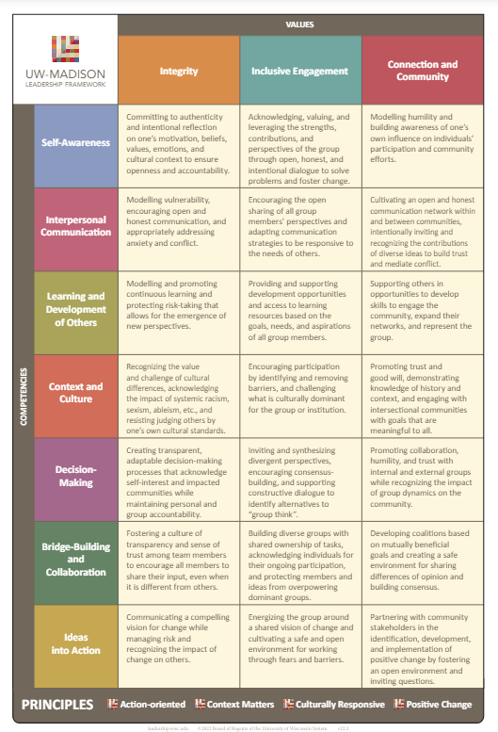
Notes:
Carlie

Slide 6
Activity
Which of these do you feel the most confident?
Which of these do you feel the least confident?
Choose a competency you want to improve. How will you practice? How will you measure your growth?
From: Center for Leadership & Involvement (CfLI)

Slide 7
Text slide: 1 column
General Student Org Matters & Reminders
You must re-register with the University every fall
Fall 2024 Deadline: October 11
Review policies at:
Student Organization Resource & Policy Guide
Alcohol
Car Fleet
Food
Posting, Chalking, & Leafleting
Political Activity & Protest Guidelines
Law School Student Affairs Knowledge Base - NEW!
Bulletin boards
Student org lockers in Mike Hall
Notes:
Carlie

Slide 8
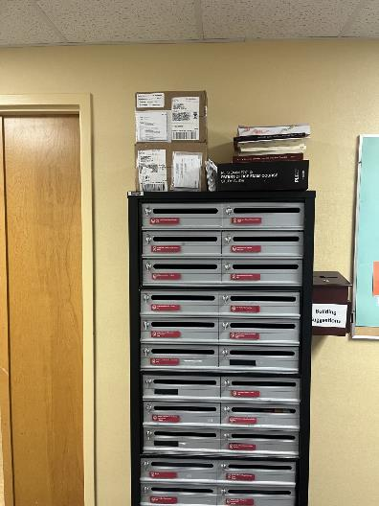
Text slide: 1 column
General Student Org Matters & Reminders: Mailboxes
Check your mailbox EVERY WEEK, including finals and summer
If the bulk of your mail is bank statements, consider switching to electronic delivery
If you do not have a mailbox, your mail will be on top of the cabinet until we get boxes updated
If these are your books, please take them by Sept 13.
Notes:
Carlie

Slide 9
Text slide: 1 column
General Student Org Matters & Reminders: Advising Updates
Carlie Wiseley’s office is currently Room 2330, in External Affairs.
Please make appointments with Carlie via Starfish
Next fall, all UW Madison student organizations will be required to have a faculty or staff advisor.
Notes:
Carlie

Slide 10
Policy Highlights

Slide 11
Text slide: 1 column
Political Activity & Public Advocacy
Quick guide with links to policies relevant to RSOs on the Law School Knowledge Base
There have been some updates to campus guidelines over the summer, so please review policies carefully!
UW-6013: Expressive Activity has replaced UW-6011: Protest Guidelines
Expressive Activity references the First Amendment
If you are hosting a candidate, there are limits to how many and what kinds of events they can do on campus. Do not rely on their team to interpret the policy.
Notes:
Carlie

Slide 12
Text slide: 1 column
Student Organization Alcohol Policy
At any event where alcohol is present, on or off campus, you should have sober monitors who have completed the sober monitor course in the past calendar year.
UW-2003 Registered Student Organization Alcohol Policy (SOAP)
UW-2002 Registered Student Organization Code of Conduct
If your event takes place at a venue without an alcohol permit, alcoholic beverages are limited to beer (fermented malt beverages) and wine. Common sources of alcohol such as kegs, bowls, boxed wine, etc. are not permitted.
Visit Hosting Events with Alcohol on the KnowledgeBase for additional tips and resources.
Notes:
Carlie

Slide 13
Text slide: 1 column
Updates to Law School Posting Policy
Handbook 18.2.3 General Postings
Posters should be no larger than 8.5x11
Postings must include:
The name of the organization
The date of the event or a date to remove
You may post:
One posting per bulletin board not designated for exclusive dept or org use
One posting in one plastic sign holder on one of the columns in the atrium
Notes:
Carlie

Slide 14
Text slide: 1 column
Events & Meetings: Calendar & Spaces
Click here to access the Law School calendar and make reservations
Submit all RSO events, regardless of whether you need a room at the Law School, so all events are advertised in one place and conflict can be avoided.
Requesting a room in the Law School does not guarantee a reservation.
Tip: Use the “description” section of the form to write a tagline for your event!
Special events or events that include external audiences are NOT allowed in the evenings or weekends unless you get permission from Carlie Wiseley or the Dean’s Office.
General org and student meetings may be outside of regular business hours, as long as there’s no external audiences or guest speakers.
*New this year: You must meet with Carlie prior to any event with external audiences or speakers.
Lubar is primarily designated for faculty and Dean’s Office events. Any event hosted in this space must be sponsored by the Dean’s Office or have a Law School faculty/staff sponsor who will be present during the entire reservation and agree to bear any financial responsibility of the group using the space.
Click here for campus-wide room reservations
Notes:
Carlie

Slide 15
Text slide: 1 column
Events & Meetings: Other Logistics
Follow university protocols and requirements for events involving food, alcohol, etc.
SORPG
Law School Handbook
Visit the Law School Copyshop on the 2nd floor of the Law building for copying of flyers, signs, brochures, name cards, etc.
The design of original materials is up to the organization unless University branding or marks are used, then they may be subject to trademark issues.
Cooperative Programming Opportunities with Law School Departments
Counselor: John Schneider
Student Success, Diversity, Equity, & Inclusion: Michael States & Kira Stewart
OCPD: Emily Kite
Notes:
Carlie

Slide 16
Text slide: 1 column
Guidance for Use of Licensed Images & Logos
All UW and UW Law School logos, shields, and UW terminology are owned by campus and need approval by the UW Trademark office.
If you plan to use any UW images, designs or logo on merchandise, materials, website, etc., please contact Carlie Wiseley to ensure your design is within campus guidelines.
If you plan to sell any UW branded products, you must use Underground Printing or AdMadison. These are the only two vendors licensed to do items for third party sales.
Failure to comply with any of these policies could result in a fine or campus disabling your sale, website or event.
Notes:
Carlie

Slide 17
Text slide: 1 column
Guidance for Fundraising
Selling items
Must pay sales tax and use licensed vendors to produce items.
Further guidance from SORPG Finances & Dept of Revenue
Soliciting gifts
Most of the student orgs at the Law School are not 501(c)3 organizations. It is important to communicate this with donors.
If you are a non-profit, you need to file taxes and provide a gift receipt.
Who to contact
Law firm and non-campus organization funding requests - Jini Jasti
All other fundraising, including selling branded merch - Carlie Wiseley
Notes:
Carlie

Slide 18
JD Grants & Funding

Slide 19
Text slide: 1 column
JD Grants 2024-2025
JD Grants Deadline: | Applies to events on or after:
September 15, 2024 | October 30, 2024
October 15, 2024 | November 30, 2024
December 1, 2024 | January 10, 2025
January 15, 2025 | February 28, 2025
February 15, 2025 | March 30, 2025
Requests are due by the deadline that is at least six weeks before the event.
Click here to access the JD Grants website
Notes:
Mary Ann or Ryan

Slide 20
Text slide: 1 column
JD Grants: Registration Fees & Event Expenses
In most cases, Adam Bushcott can pay registration fees directly. He will register participating students when he pays the fee. At least 4 weeks in advance, you must provide the information needed to register students and pay the fee.
The Law School requires event documentation before paying registration fees and event expenses (i.e., JD Grants funding approval & event website/schedule/program)
If you are hosting a local event, some expenses can also be paid directly by the Law School, e.g. venue, marketing, equipment rental, etc. Talk to Carlie in the early stages of planning to minimize the need for paying upfront and requesting reimbursement after the event.
Notes:
Jennifer

Slide 21
Text slide: 1 column
JD Grants: Documentation for Food Purchases
Documentation Must-Haves
Event documentation (event schedule, website, flyer, program, email announcement, agenda, etc. that includes who, what, when, and where)
Attendance list (participant names + affiliation to UW/Law School)
Law School Business Office - Events - Meal Payment Form (available on the JD Grants “Forms” webpage)
Itemized receipts (if someone needs to be reimbursed)
All documentation should be submitted electronically to Adam Bushcott and Jennifer Gardner-Brokmeier. Please make sure original receipts are clearly scanned.
Notes:
Jennifer

Slide 22
Text slide: 1 column
JD Grants: Reimbursement for Local Events
Essential Rules for Food-Related Purchases
Only individuals can be reimbursed (not student organizations)
Sales tax is not reimbursable (ask Adam Bushcott for a UW tax exemption certificate to provide to the vendor)
Request reimbursement soon after the event ends (within 2 weeks if possible)
Include reimbursement information in the email with the Meal Payment Form (names of people to be reimbursed, their contact information, amount due to each person, and itemized receipts)
Reimbursement for Non-Food Purchases
Contact Adam Bushcott and ask what documentation you need to provide in order to be reimbursed. As with food purchase, only individuals can be reimbursed, and sales tax is not reimbursable.
Notes:
Jennifer

Slide 23
Text slide: 1 column
JD Grants: Post-Event Forms
Actual Expenses Report Forms
Fill out the appropriate Actual Expenses Report Form. (Forms vary depending on the type of event.)
The form is due to jdgrants@law.wisc.edu after the event. See the various deadlines on the JD Grants webpage with the forms.
This report is required even if the Law School prepaid all expenses and no reimbursement is requested.
Attendance Report for Student Travel Awards
Confirm that students used the Travel Awards.
Due to jdgrants@law.wisc.edu one week after the trip.
Notes:
Mary Ann or Ryan

Slide 24
Text slide: 1 column
Reimbursement
Items needed for reimbursement or P-Card Prepay
Meal payment form (food)
Attendance List
If you are serving food, you MUST take attendance or have a sign-in sheet. Make sure to include people working the event.
Agenda and/or Event Announcement
Email to students (SBA announcement counts)
Flyer
Notes:
Adam

Slide 25
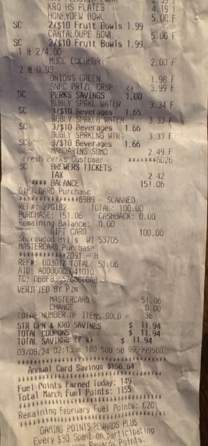
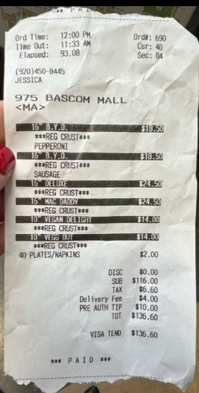
Reimbursement - Receipts
Receipts MUST include:
Business name
Date
Itemized purchases
Not a credit card receipt
CC receipt can be used for showing the tip
Two bad examples →
Notes:
Adam

Slide 26
Reimbursement - Business Purpose
Business purpose: Clear purpose to how this enhances the mission of the UW & your group.
Example
Not acceptable:
Lunch during 7+ hour training event for new members.
Acceptable:
The Wisconsin Law Review held its New Member Orientation on August 25th. This orientation was a full day and included a provided lunch break for the students. During orientation, the new members learned about WLR, introduced themselves to the Board and associates, and were trained on how things work in the WLR office. After the orientation, new and current members met at the Memorial Union Terrace and had a Meet & Greet.
Notes:
Adam

Slide 27
Text slide: 1 column
JD Grants: Travel Awards and Financial Aid
Students who are receiving aid at or near their Cost of Attendance:
May see their semester loan disbursement reduced
May owe a balance on their tuition account following receipt of the travel award
Contact Heidi Johnson (heidi.johnson@wisc.edu) with questions about the impact on your individual financial aid.
Notes:
Heidi

Slide 28
Text slide: 1 column
Other Sources of Funding
Student Bar Association (SBA)
$15,000 available
Process will start earlier than past years - stay tuned to SBA Newsletter!
Consider co-sponsoring with relevant Law School Depts.
State Bar of Wisconsin
Associated Students of Madison (ASM)
Suggestions from CfLI
Multicultural Council Grant (MSC)
Wisconsin Experience Grant (CfLI)
Global Badger Experience Grant (ISS)
University Lectures Committee
*If you apply to other grants outside of the UW, you might like these resources
Notes:
Carlie

Slide 29
Text slide: 1 column
People to Know
Student Org Policies & Logistics: Carlie Wiseley, Student Life & Engagement Manager
Technology Questions: Help Desk (help@law.wisc.edu)
UW Image Use & Fundraising:
Carlie Wiseley, Student Life & Engagement Manager
Jini Jasti, Associate Dean for External Affairs & Alumni Relations
JD Grants: Ryan Poe-Gavlinski, JD Grants Committee Chair
Travel, Expenses, & Reimbursements:
Jennifer Gardner-Brokmeier, Law School Accountant
Adam Bushcott, Law School Main Office Manager
Emergency Loans & Financial Aid Questions: Law School Financial Aid Office (financialaid@law.wisc.edu)

Slide 30
Share this information with your fellow student leaders not in attendance today!

Slide 31
You’ve got mail!
BLSA | Moot Court
BATLaw | NLG/Socialist Law | TIPSO
ELS | PILF | WACDL
FGL | QLaw | WILJ
GovLaw | Real Estate & Securities | WJLGS
LESA | SELS | WLR
MELSA | SBA | WLSA

