Slide 1


AI & Legal Skills Virtual Conference
Orienting Students to AI Use in Law School: Tools, Ethics, and Professional Judgment
Kim Holst and Sue Chesler, Dean’s Innovation Fellows and Clinical Professors of Law

Slide 2
Why introduce AI at Orientation?
Early Intervention
Introduce AI early and as a tool with benefits as well as challenges
Put it in context—both as a student and for the future (IRL)
Give concrete examples of effective use and harmful use
Explain the “why”
Make AI part of the learning process and academic environment
Captures all students—doesn’t relegate it to a single class
Suggest additional resources

Slide 3
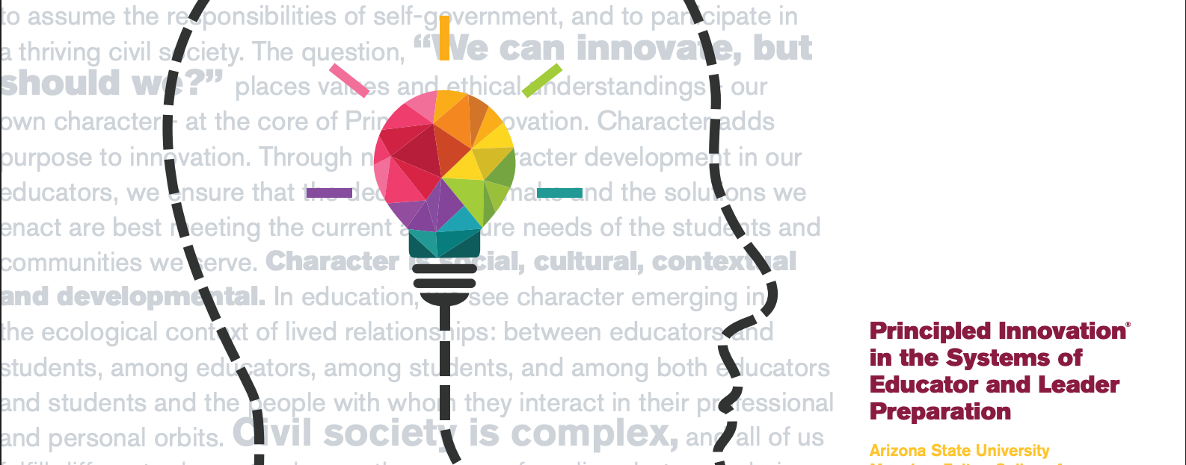
Principled Innovation Framework
Moral, Civic, Intellectual, Performance Assets in Action
https://pi.education.asu.edu/

Slide 4
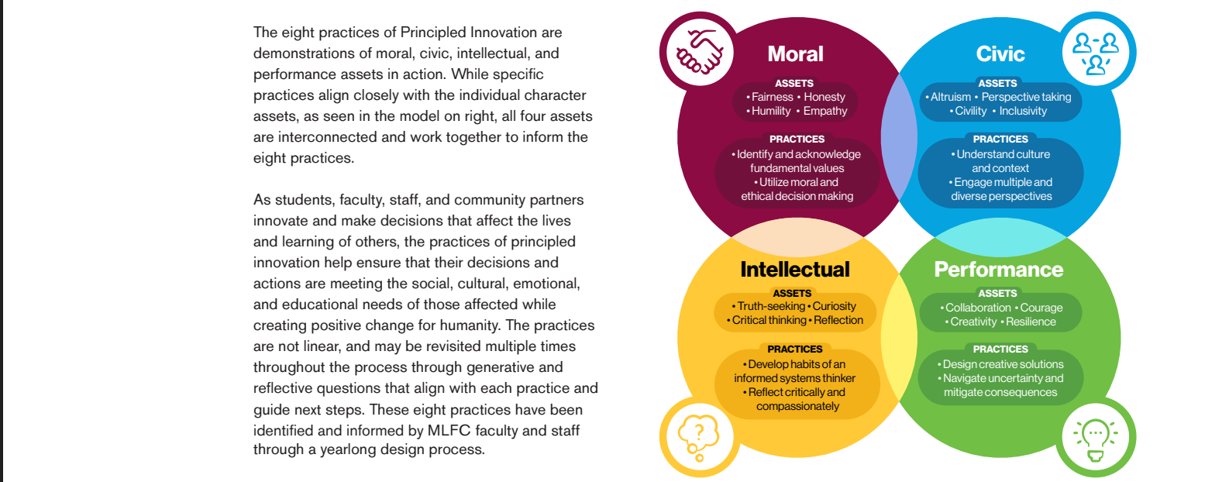
Principled Innovation Framework
Moral, Civic, Intellectual, Performance Assets in Action

Slide 5
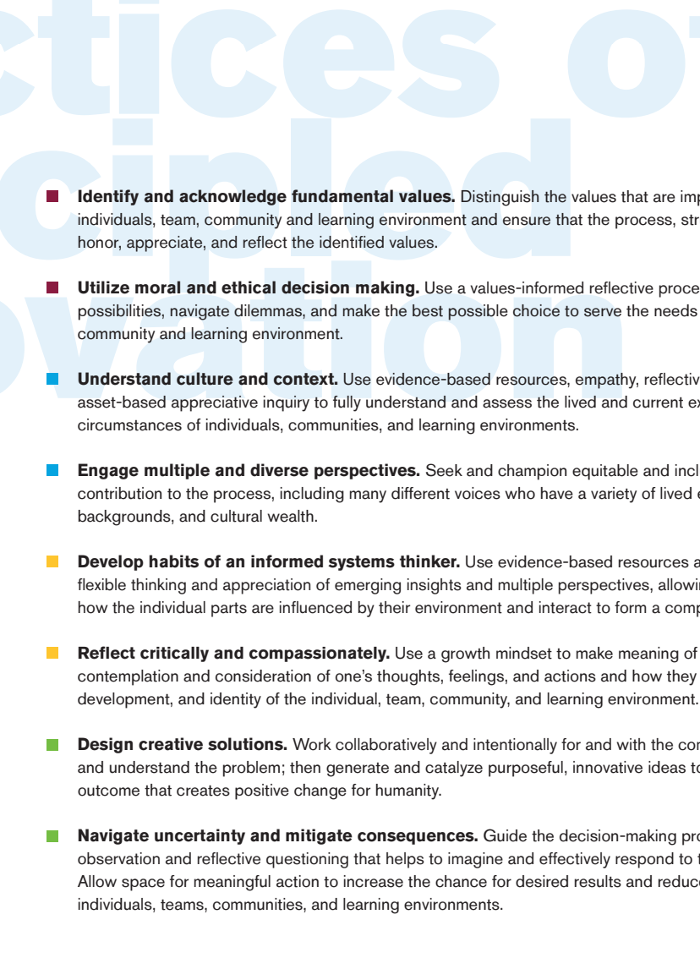
Principled Innovation Framework
Moral, Civic, Intellectual, Performance Assets in Action

Slide 6
The following slides contain content from the orientation presentation from 2025.

Slide 7
ASU Law School Orientation
Thinking Like a Lawyer with AI: Tools, Ethics, and Professional Judgment

Slide 8
Introduction and Roadmap
Professors Chesler and Holst
Understanding AI in the Legal Context
Academic Integrity & Ethics
Practical Applications for 1Ls
Professional Practice Preview
Best Practices & Guidelines
Q&A

Slide 9
By the End of This Session, You Will:
Learning Objectives
✓ Understand AI's capabilities and limitations in legal contexts
✓ Know how to use AI ethically within academic constraints
✓ Have practical tools for AI-assisted studying and class preparation
✓ Recognize the boundaries between AI assistance and academic integrity

Slide 10

Understanding AI in Legal Context
What every law student needs to know about artificial intelligence

Slide 11
Understanding AI in the Legal context
What is AI? Large Language Models
What AI is Good at
What AI is Bad at
Hallucinations

Slide 12
Academic Integrity & Ethical Framework
Building ethical foundations for AI use

Slide 13

Core Principle:
AI as a Study Tool, NOT a Replacement
The Learning Imperative:
1L year builds foundational thinking skills
These skills cannot be developed through AI shortcuts
AI should enhance, not replace, your learning process

Slide 14
Before Using AI, Ask:
Decision Checklist
1️⃣ What are my professor's specific policies?
2️⃣ What are my school's academic integrity rules?
3️⃣ Does this assignment prohibit AI assistance?
4️⃣ Am I using AI to learn or to avoid learning?

Slide 15

Why This Matters for Your Career
Professional Identity Development
Lawyers must exercise independent professional judgment
Clients rely on YOUR expertise, not AI's
Ethical obligations require competence and diligence
Building strong foundational skills now prevents future problems

Slide 16
🚫 RED LINES - When NOT to Use AI:
Don’t cross these lines
❌ Graded assignments (unless explicitly permitted)
❌ Take-home exams
❌ Research papers (without professor approval)
❌ Any work that will be submitted for evaluation

Slide 17
Practical Applications for 1L Students
Real tools you can use immediately

Slide 18
Practical Applications for 1L students
Creating a study schedule
Note summarization and organization
Creating study materials
Practice question generation
Building a custom study GPT

Slide 19
Professional Practice Preview
A glimpse into your future career

Slide 20
Professional Practice Preview
How lawyers use AI today
Professional ethical considerations
After 1L year: Advanced Applications

Slide 21
Best Practices & Guidelines
Your ethical framework for success

Slide 22
The A.I.D.L.E. Framework
(Aid Legal Education)
Always verify AI outputs
Identify potential biases
Double-check facts and citations
Learn actively, don't just consume
Ethical compliance first

Slide 23
Quick Decision Tree
Before using AI, ask:
1. Is this permitted? → Check policies
2. Will this help me learn? → Focus on understanding
3. Am I staying engaged? → Don't become passive
4. Can I verify the output? → Always fact-check
5. Am I being transparent? → Follow disclosure requirements

Slide 24

⚠️ Warning Signs of Over-reliance
STOP using AI if you find yourself doing ANY of these things:
Skipping assigned readings because “AI can summarize”
Unable to explain concepts without AI assistance
Anxiety when AI is not available
Declining performance despite increased AI use
Loss of confidence in your own analytical abilities

Slide 25
Key Takeaways
In summary:
AI is a powerful study tool, not a replacement for learning
Always operate within your professor's and school’s guidelines
Verify all AI-generated legal information
Use AI to enhance your understanding, not avoid thinking
Develop your own analytical skills alongside AI literacy
Professional success requires independent judgment

Slide 26
Questions for Reflection
How can AI help you become a better law student without compromising your learning?
What systems will you put in place to ensure ethical AI use?
How will you balance efficiency gains with skill development?

Slide 27
Resources
School Resources:
Student Services
Library AI resources
Vendor trainings
Professor office hours
Professional Development:
ABA publications on AI in law
Legal technology CLEs
Bar association AI committees

Slide 28
Remember:
Use AI as a study partner, not a study replacement.
The goal is not to make studying easier, but to make your learning more effective.
Welcome to ASU Law!

Slide 29
Questions?

