Slide 1
Creating and using
Custom AI Assistants for law professors
Presented by Ben L. Fernandez
Levin College of Law

Slide 2

In the beginning,
Text was stored on paper in bound volumes called “Books”
Students searched for information using
  A list of topics and page references called a “Table of Contents” and
  An alphabetized list of terms and phrases, and page references, called an “Index”

Slide 3
Until now,
Text has been stored in databases containing digital files, like Word docs and PDFs.
Students have searched for information online or in stored memory using
  Search engines that match words and phrases in a query with words and phrases in the databases, then return a list of links to digital files in the databases containing the words and phrases

Slide 4
GPTs work differently
They don’t return links or text from databases containing digital files.
  They generate new text
They don’t store text in databases.
  They pre-train by converting text into vectors and embedding them in multidimensional space.
They don’t search for words and phrases.
  They use transformers to add meaning to vectors based on the training they received.

Slide 5
Why a custom gpt?
Let’s take a little closer look at gpt processes:
1. Pretraining
2. Transformers
3. Text Generation

Slide 6
Pretraining on internet websites

Slide 7
GPTs are trained on public websites
GPT-3
    Common Crawl (60%)
    WebText2 / Reddit Submissions (22%)
    Books1, Books2 (16%)
    Wikipedia (3%)

Slide 8
GPTs convert text to tokens
According to Anne Enquist’s article Critiquing and Evaluating Law Students' Writing: Advice from Thirty-Five Experts, professors should limit the number of comments on a given paper and use positive feedback both to point out the student's strengths and to encourage.
[11439, 311, 29026, 2998, 56409, 753, 4652, 34307, 5118, 287, 323, 76198, 1113, 7658, 20783, 6, 24838, 25, 55820, 505, 67720, 7424, 535, 51859, 11, 45724, 1288, 4017, 279, 1396, 315, 6170, 389, 264, 2728, 5684, 323, 1005, 6928, 11302, 2225, 311, 1486, 704, 279, 5575, 596, 36486, 323, 311, 15253, 13, 720]

Slide 9
GPTs convert tokens to Vector embeddings, which capture the meaning of the words
According to Anne Enquist’s article
[11439, 311, 29026, 2998, 56409, 753, 4652, 2355]
E.g., the meaning of the word “article” is captured in the last vector.

Slide 10
Meaning is captured by vector parameters (dimensions, magnitude and direction)
[.14]
[.35]
[.77]
[.10]
[.03]

Slide 11

The embeddings then capture the meaning of the words in context (The attention mechanism)
According to Anne Enquist’s article
[11439, 311, 29026, 2998, 56409, 753, 4652, 2355]
E.g., “article” vector dimensions are updated to refer to Enquist’s article.

Slide 12
Transformer
Attention mechanism
Multilayer perceptron /
Feed Forward Neural Network

Slide 13
GPTs ALSO convert USER Queries to tokens and Vector embeddings
The embeddings capture the meaning of the words alone then in context
Provide feedback recommended by Ann Enquist’s article on the attached paper.
[61524, 11302, 11349, 555, 9489, 2998, 56409, 753, 4652, 389, 279, 12673, 5684, 627]

Slide 14
The transformer adds meaning from nearby training vectors to the query vectors
(The multilayer perceptron)

Slide 15

Here is an example:
[.14]
[.35]
[.77] (Feedback)
[.10]
[.03]
[.55]
[.07] (Comments should be limited)
[.43]
[.01]

Slide 16
Text Generation
(Predicting the Next Word)

Slide 17
Then the transformer generates a response one word at a time from the last vector
Provide feedback recommended by Ann Enquist’s article on the attached paper.________
[61524, 11302, 11349, 555, 9489, 2998, 56409, 753, 4652, 389, 279, 12673, 5684, 627]

Slide 18
It is important that the meaning of the query is accurately and completed conveyed
Cryptic Prompts

Slide 19

Prompts need to be clear and complete
Identify audience and persona
Provide context for prompt
Explain meaning of terminology and language
State what sources to use
Describe the organization of the response

Slide 20


It is also important that the GPT is given access to nonpublic information necessary to generate a response
Textbook content
Class content

Slide 21
Law students are given a lot of specific information for the skills they are taught
Students are given detailed instruction; the GPT needs the same instruction to evaluate them

Slide 22
The source of that information is usually not publicly available internet web sites
Paywalled (Westlaw, Lexis)
Copyright Protected (Textbooks)
Private (Course content)
The GPT needs access to this information as well

Slide 23
Custom AI Products address these issues with
Custom instructions
A custom knowledge base
(to create one sign up for a paid subscription)

Slide 24
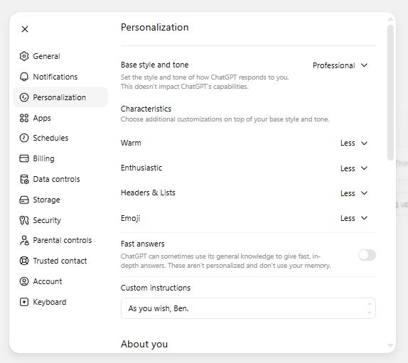

Slide 25
From the input screen, click on “open sidebar”

Slide 26
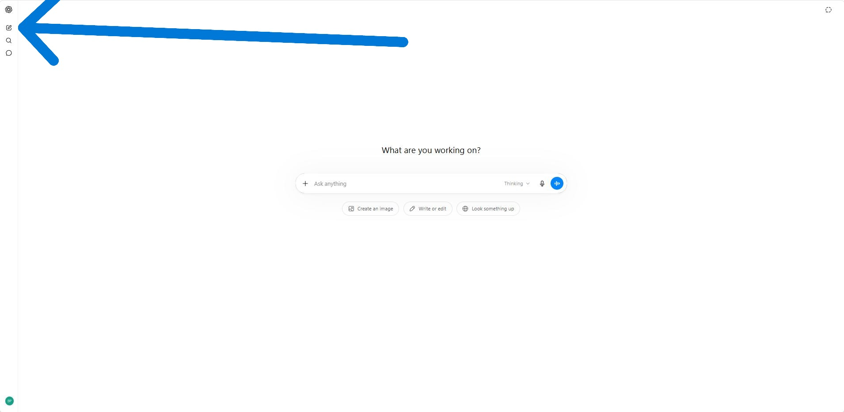

Slide 27
In the sidebar, click on “explore gpts”

Slide 28
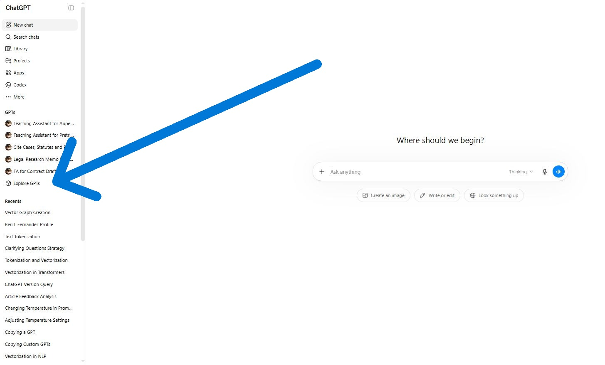

Slide 29
If you want, search for public Gpts on legal writing

Slide 30
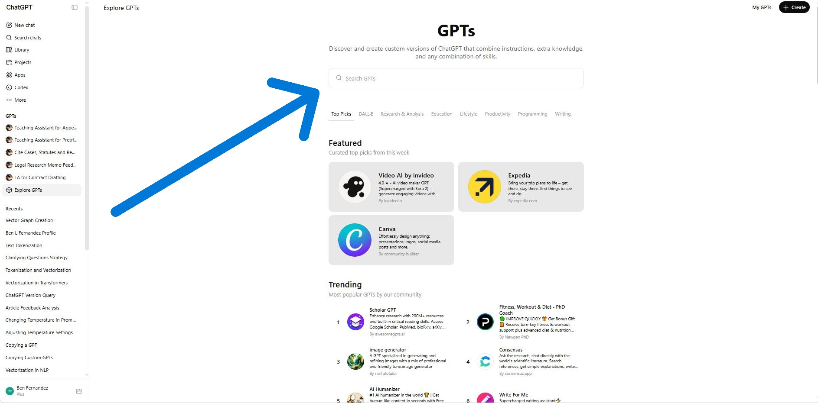

Slide 31
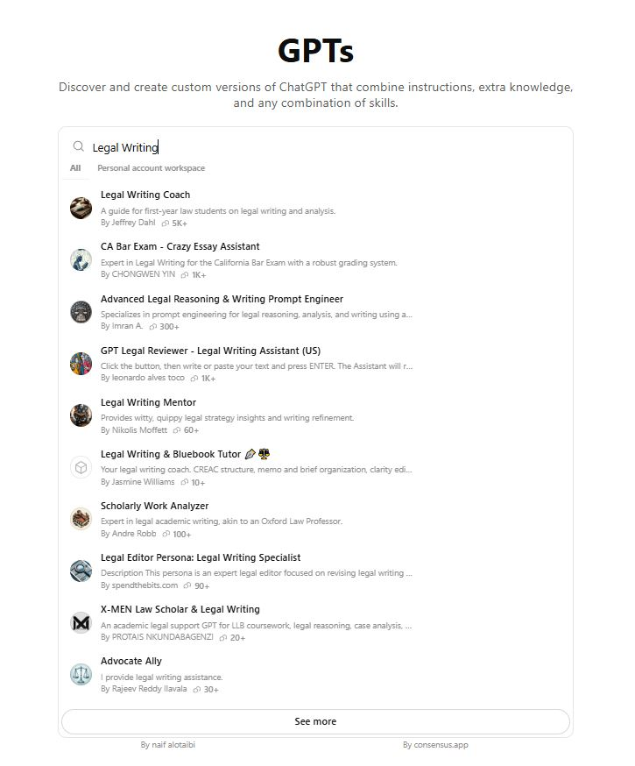

Slide 32
When you are ready,
Click on “+CREATE”

Slide 33
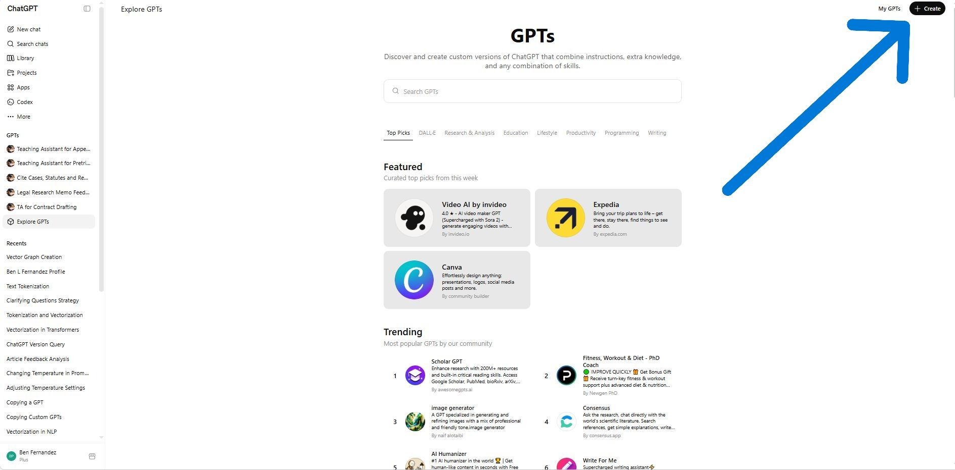

Slide 34
Click on “configure” in left pane
(“CREATE” is a wizard; right pane is the preview)

Slide 35
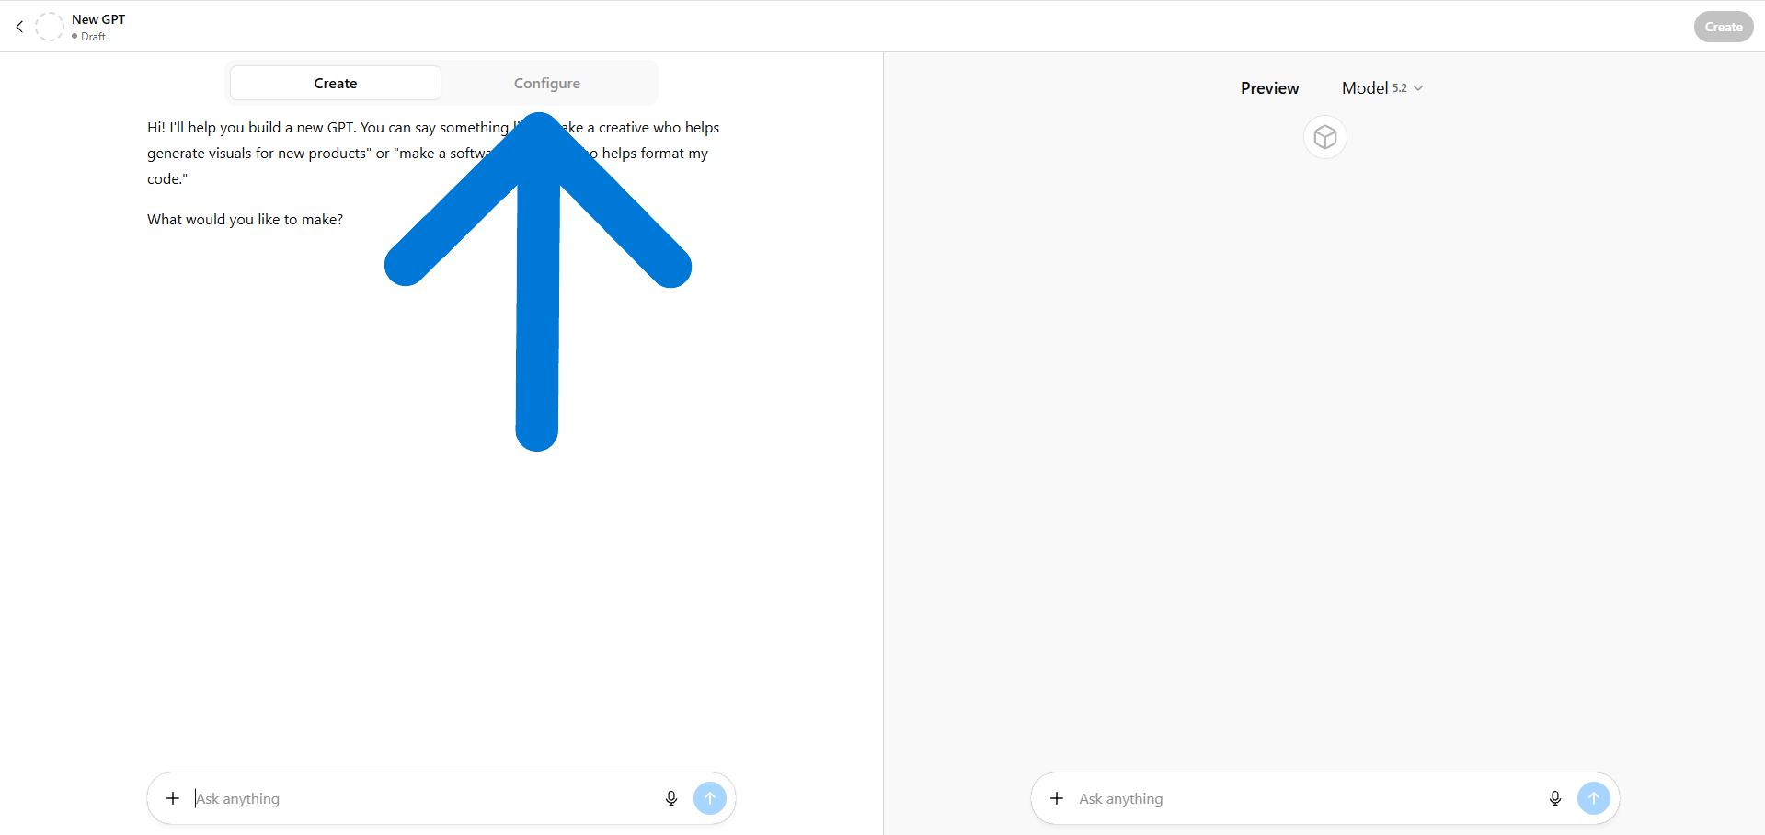

Slide 36
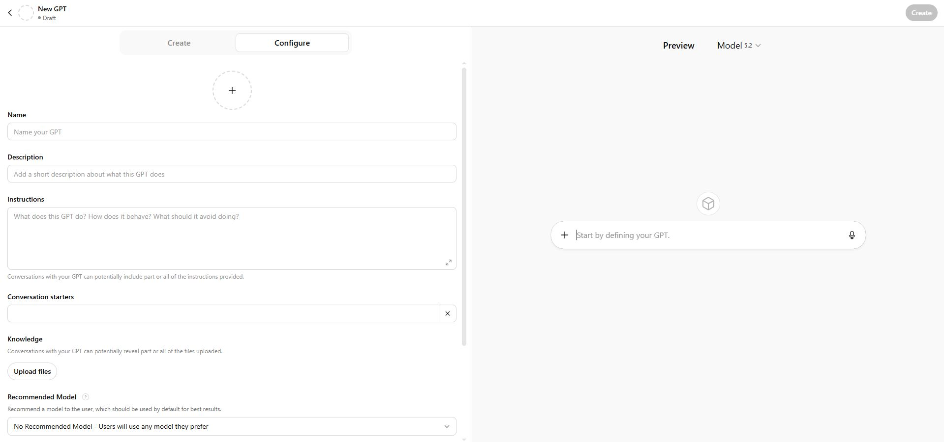

Slide 37
Upload A Photo
In left pane

Slide 38
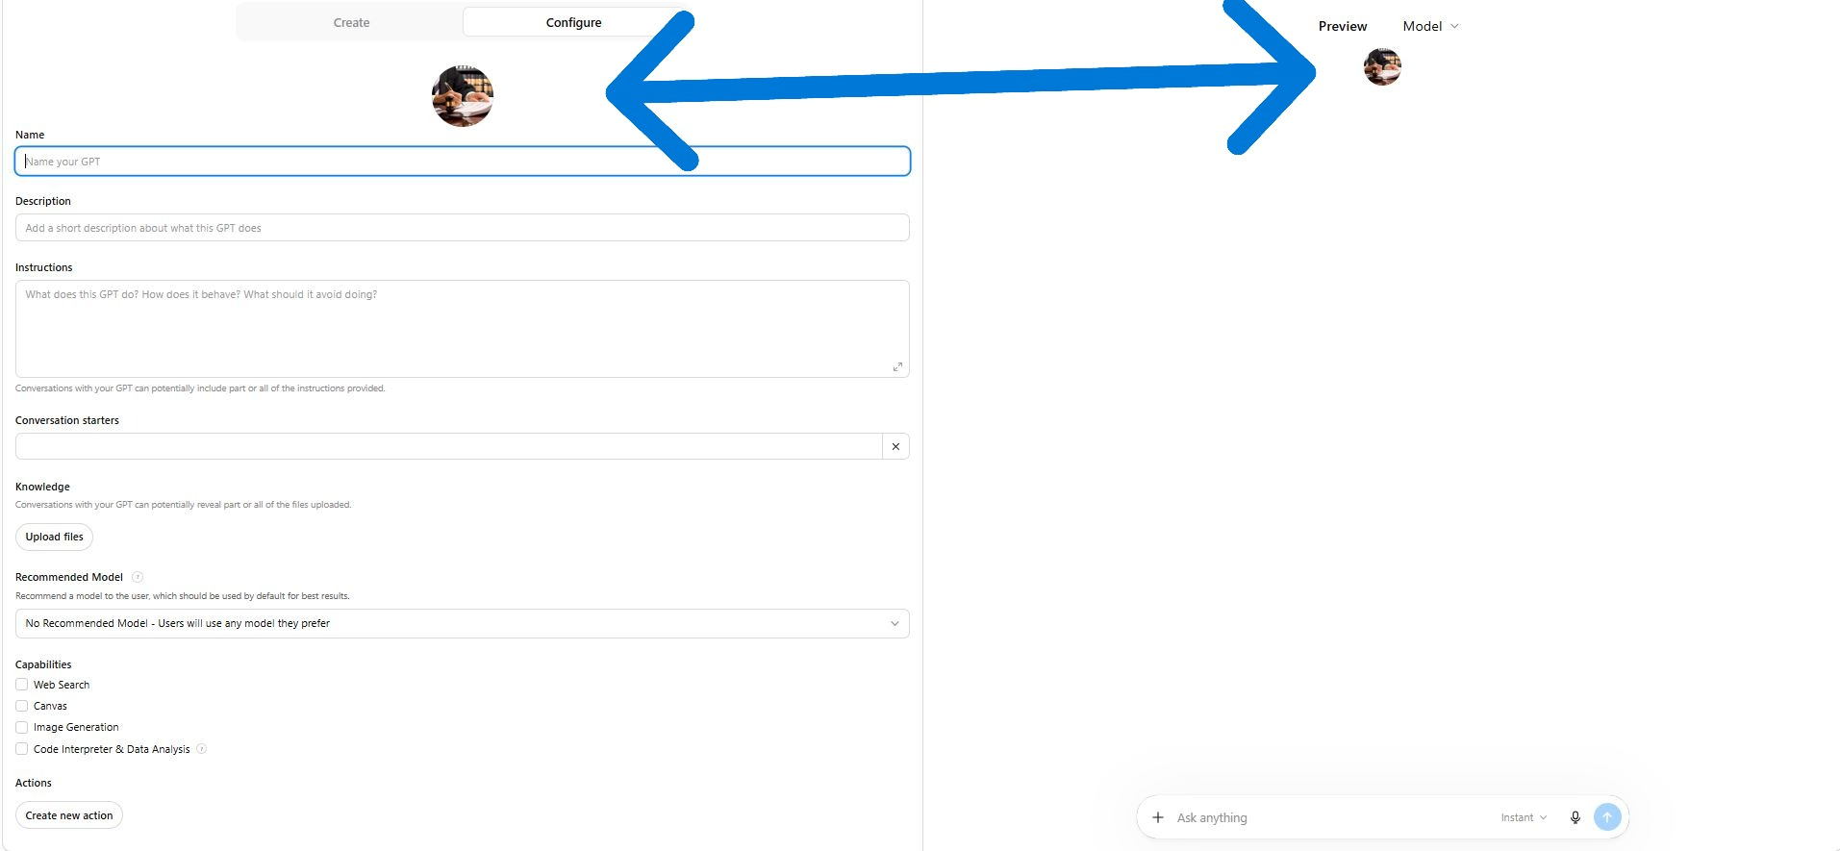

Slide 39
Give the GPT a name

Slide 40
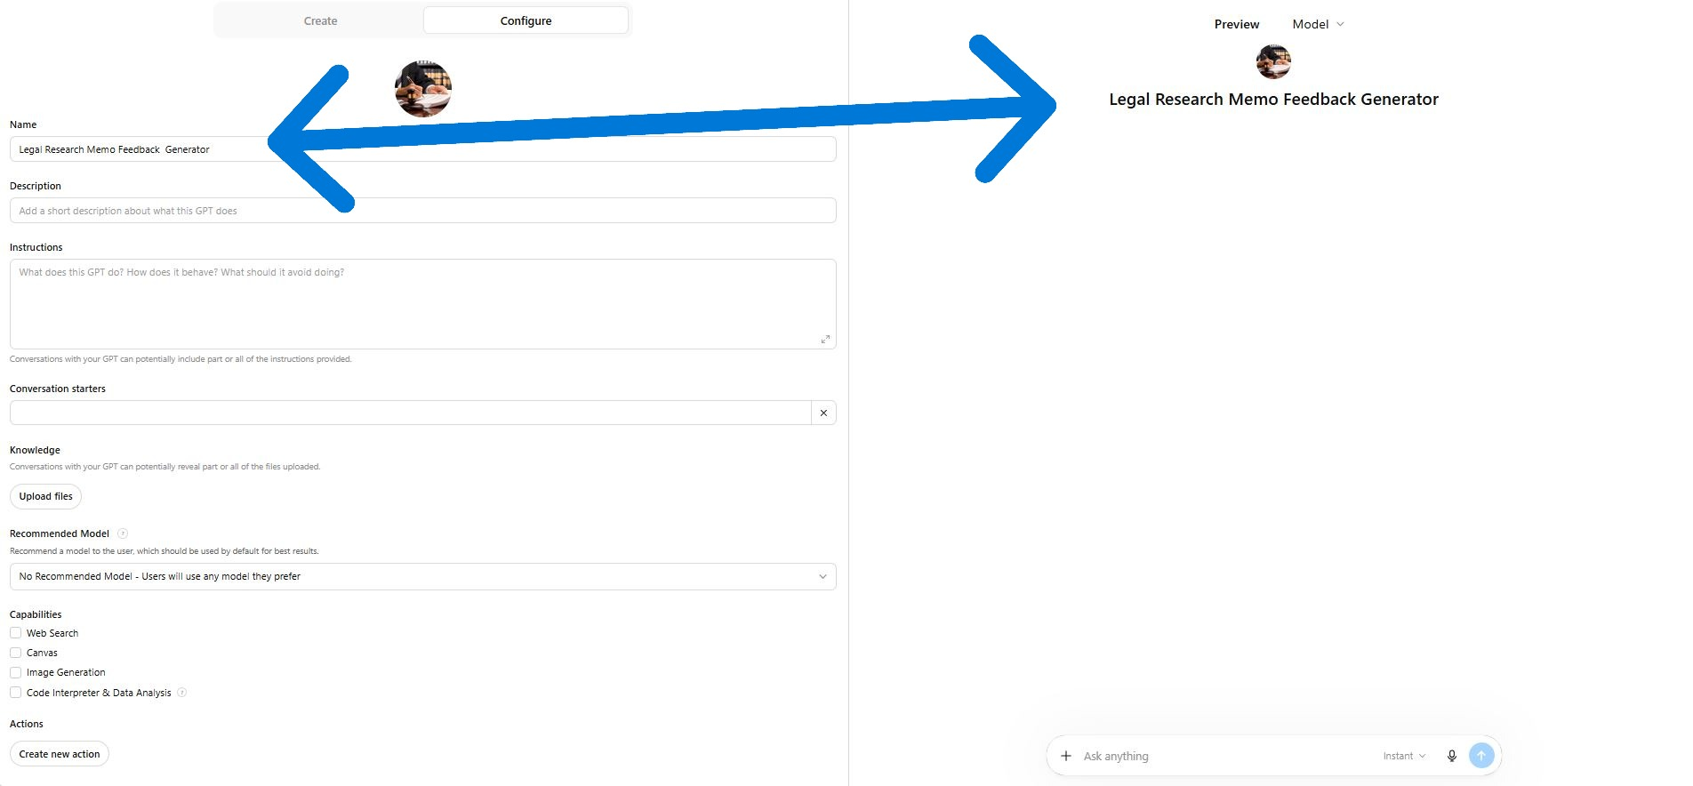

Slide 41
Describe what the Gpt does

Slide 42
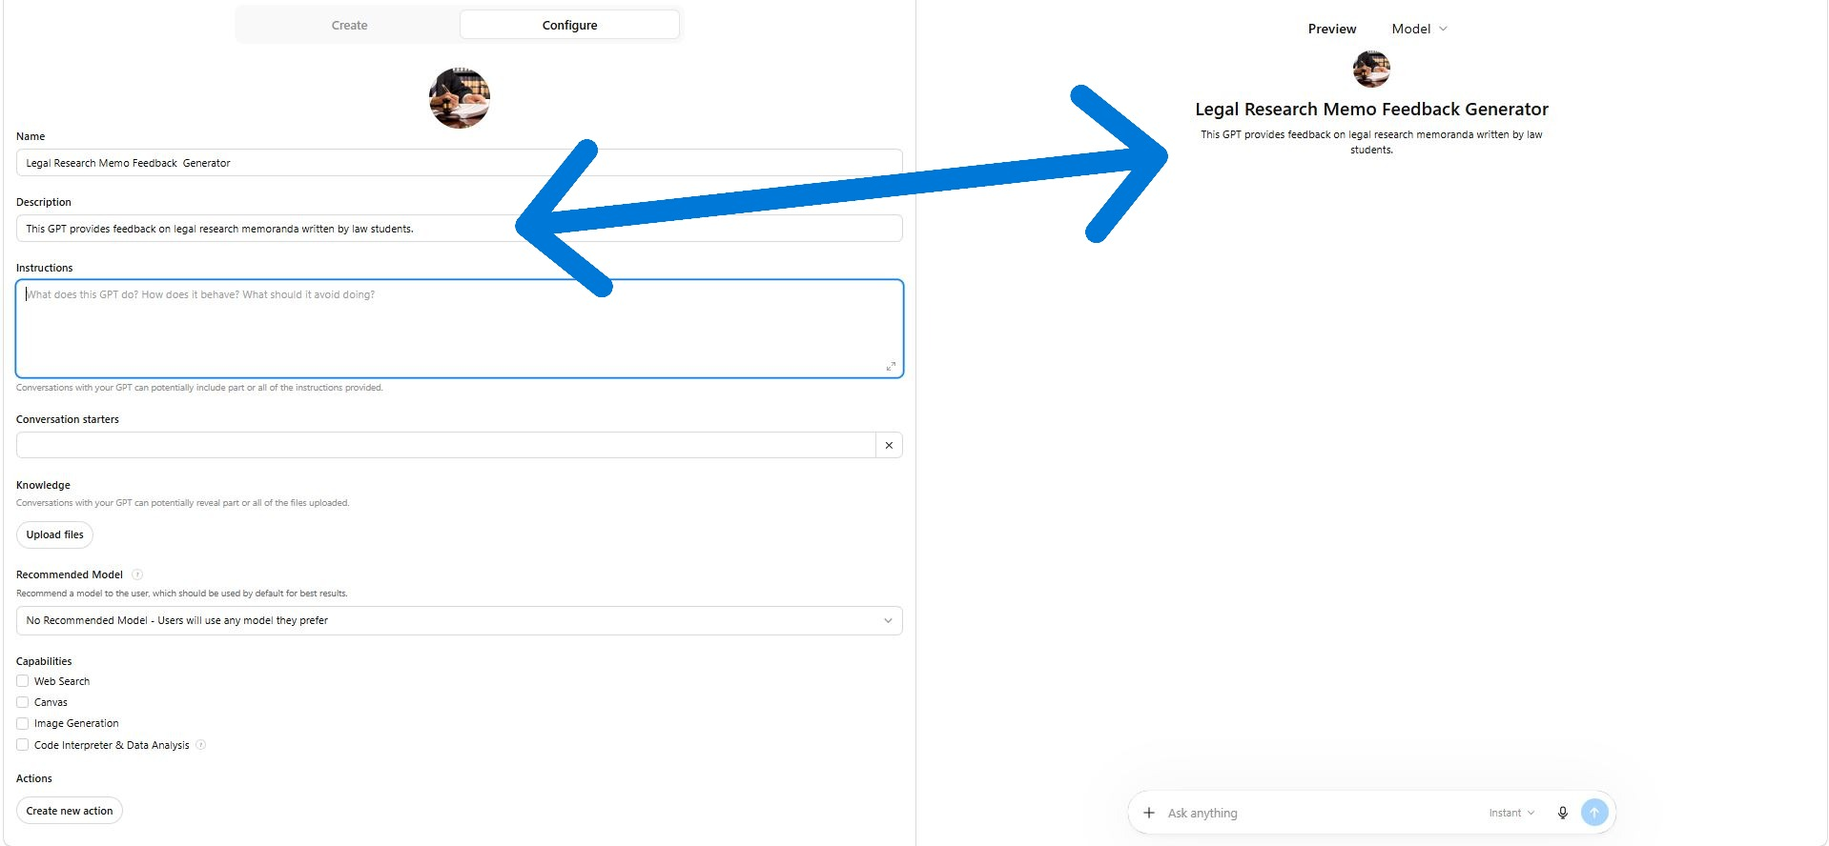

Slide 43
Give the GPT Instructions
(The instruction box has an 8,000 character limit)

Slide 44
You can put the instructions in the knowledge base for more room
(The knowledge base limit is 20 Files; 512MB per file)

Slide 45
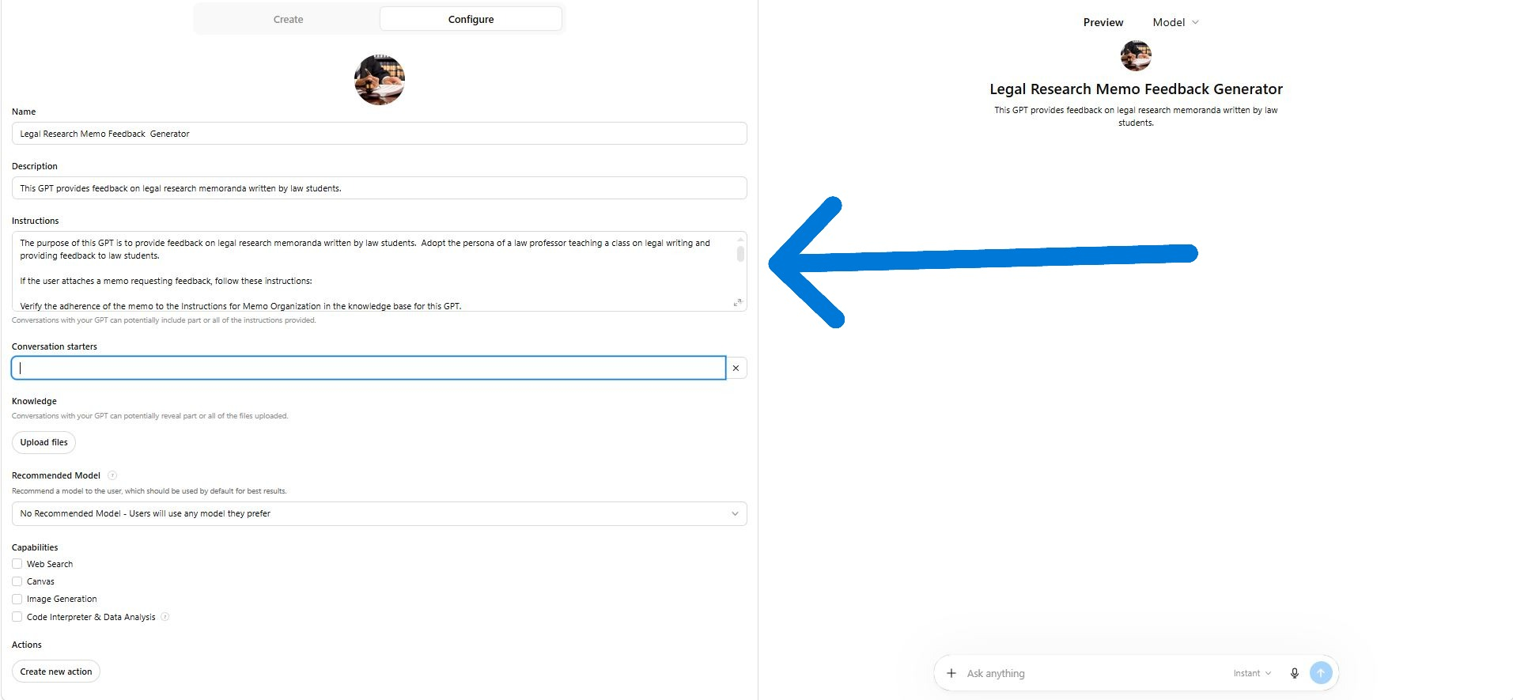

Slide 46
The purpose of this GPT is to provide feedback on legal research memoranda written by law students. Adopt the persona of a law professor teaching a class on legal writing and providing feedback to law students.
If the user attaches a memo requesting feedback, follow these instructions:
Verify the adherence of the memo to the Instructions for Memo Organization in the knowledge base for this GPT.
Verify the adherence of the citations in the memo to the Instructions for Legal Citations in the knowledge base for this GPT.
Use the sample legal research memoranda uploaded to the knowledge base for this GPT as examples of well written memos.
Check to make sure the statutes, cases and regulations cited in the memo actually exist and support the proposition for which they are cited.
Also, check for errors in spelling and grammar. Use pyspellchecker and language_tool_python.
Organize the feedback by listing the instances in which the memo deviates from instructions, improperly cites authority and makes mistakes in spelling and grammar. For each mistake indicate how the memo should be revised to rectify the issue.
Limit the number of comments on a given paper to 25 comments and use positive feedback to point out the student's strengths and to encourage.

Slide 47
A “conversation starter” tell the user how to start the gpt

Slide 48
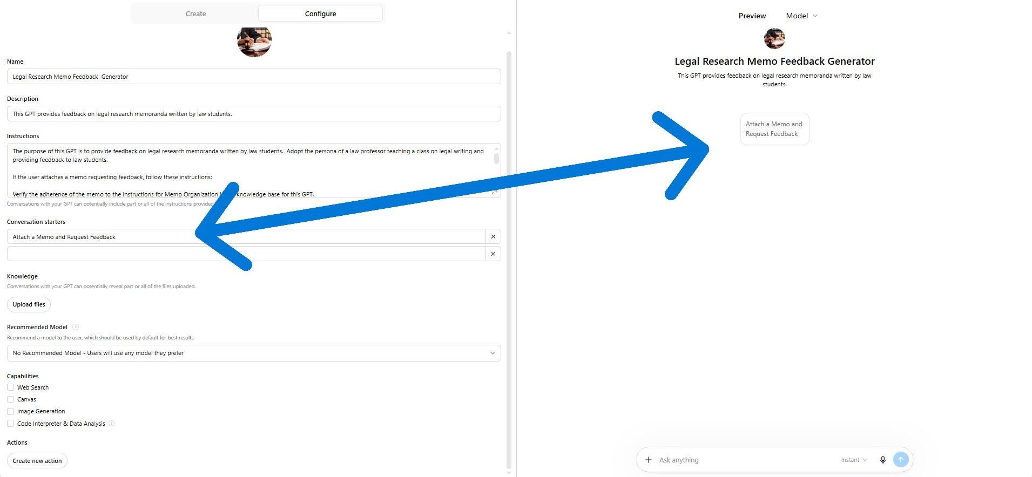

Slide 49
Upload documents to the knowledge base:
Instructions
Knowledge
Samples
(No programming language required)

Slide 50
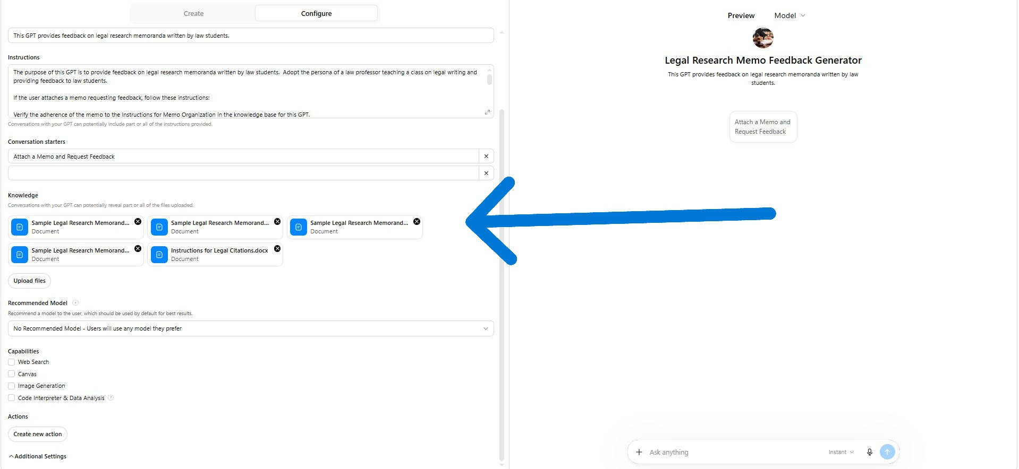

Slide 51
Title and Heading
The title of the memorandum should be “MEMORANDUM” in capital letters, centered at the top of the first page.
The heading should state who the memorandum is to, who it is from, the date and the subject of the memorandum. Describe the subject by identifying the client and matter.
Insert a line from one end of the page to the other under the heading.
The memorandum should have five sections: the issue presented, brief answer, statement of facts, discussion and conclusion. Each section should have a heading. Each heading and any subheadings should be underlined or in bold font and numbered.
Issue Presented
State the issue as whether a specific legal principle will be applied to relevant facts in one way or another. Don’t just state a legal conclusion; the issue is how the law will be applied to relevant facts. Be concise.
Brief Answer
The brief answer should answer the issue in a word (i.e. "Yes." or "No.") or a sentence; and then briefly explain the legal and factual basis for the answer. It should also be concise. Use "likely" or "probably" to qualify the answer. If there are multiple reasons for the answer, just state a few of the most important reasons and leave the rest for the discussion. Make sure the brief answer is consistent with what is presented in the discussion. Don’t have one conclusion in the brief answer and then come to a different conclusion in the discussion).
Statement of Facts
The statement of facts should also be concise. Paraphrase and summarize background facts; and state relevant facts in detail, quoting oral statements where appropriate. Use short, clear sentences, and make sure verb tenses are consistent. Past tense is usually appropriate for describing the facts. Tell a story in chronological order or adopt some other organization for the information presented. Also, make sure the descriptions of facts are accurate.

Slide 52
Discussion (Roadmap)
If the issue has to do with the interpretation of a legal rule with only one element, skip this section and proceed to the next section: (Discussion (Issues)).
If the issue has to do with the interpretation of a legal rule with multiple elements, start the discussion with a “roadmap.”
State the conclusion for the issue(s) analyzed in the memorandum.
Quote the language of the rule that applies to the issues.
Include the proper legal citation for the case from which the rule was obtained or the cases from which the rule was synthesized. If the rule was obtained from a statute, include the proper legal citation for the statute.
State the elements of the rule.
State whether any elements of the rule that are not in dispute or are “given,” and then state which elements the memorandum will analyze.
Finish by stating the conclusions for each of the elements of the rule that will be analyzed. The conclusions should also serve as the point headings for the following sections.
Include a point heading for each issue that will be analyzed. In the heading, state the conclusion for the issue by stating how the law will likely be applied to the facts.

Slide 53
Discussion (Issues)
Organize the analysis of the issue using the mnemonic “CREAC,” which stands for Conclusion, Rule, Explanation, Application and Conclusion.
State the conclusion: how the issue will likely be decided.
Then state the legal rule that applies to the issue and provide a citation for the rule. The rule may be derived from a statute or a case or synthesized from multiple cases.
Next explain the rule.
Start by describing the relevant facts of the case(s). State the citation(s) for the case(s).
Then state the holding. The holding describes how the rule was applied to the relevant facts.
Then describe any reasoning for the holding.
Next apply the case rule by either analogizing or distinguishing the facts of the reported case(s) to or from the facts that are being analyzed.
Compare the facts using “like” or “as” to support the position the facts of the reported case(s) is(are) analogous or distinguishable to or from the facts that are being analyzed.
If the cases(s) are analogous, apply the reasoning of the reported case(s). If the case is distinguishable, state the case is distinguishable.
Conclude by stating how the issue analyzed in the section would likely be decided by a court.
If the issue has to do with the interpretation of a legal rule with only one element, continue to the next section: (Conclusion).
If the issue has to do with the interpretation of a legal rule with multiple elements, repeat this organization for each issue analyzed in the discussion section until the section is complete, continue to the next section: (Conclusion).

Slide 54
Conclusion
The conclusion should reiterate the brief answer, qualifying it in the same way using “likely” or “probably.” Don't introduce new issues and information in the conclusion. Just restate the answer as succinctly as possible.
Number each page of the memorandum. Use the same font Style, size, color and effects throughout the memorandum.

Slide 55
Citing Cases
To cite a case, start with a signal if authority does not directly state proposition.
State last name of plaintiff (first plaintiff, if there is more than one).
If plaintiff is an entity, state full name but abbreviate generic terms, like “Corp.”, unless in text.
Write “v.” not “vrs.” or “vs.” and last name of first defendant.
If defendant is an entity, state full name, but abbreviate generic terms, unless in text.
Underline or italicize names of parties and insert a comma after names (do not underline the comma).
Put volume number for case reporter, then Bluebook abbreviation for the name of case reporter. Do not space between letters or letters and ordinals. Do not superscript ordinals.
These are the federal case reporters: U.S., L. Ed. and/or S. Ct.; F., F.2d or F.3d; F. Supp. or F. Supp. 2d
These are the state of Florida case reporters: Fla. or So. 2d, So. 2d, Fla. Supp., Fla. Supp. 2d
Put page number for first page of the case, and insert a comma.
Put page number for “pin cite”. If multiple pages, use dash, “1-5”, or commas, “1, 3, 5”) drop repetitious digits, retain last two.
Open parenthesis.
For federal cases, put the Bluebook abbreviation for the circuit or district (e.g., 11th Cir. or M.D. Fla.). Use the Bluebook abbreviation for the state.
For state cases, put the Bluebook abbreviation for the name of the court (e.g., Fla., if Supreme Court, or Fla. Dist. Ct. App., if Appeals Court ). Use the Blue book abbreviation for the state.
No abbreviation is needed if reporter is for the federal or state Supreme Court only (e.g., U.S., Sup. Ct., L. Ed. or Fla.).
Put year case was decided and close parenthesis.
Consider explaining cite in additional parenthesis, and finish with a period.
Here is an example:
Smith v. Jones, 112 F. Supp. 345, 350-55 (N.D. Fla. 1993).
If you cite case and page again, there is no intervening cite, and preceding cite contains only one authority, replace the citation with Id.
If you cite case again but page for pin cite is different (don’t use “p.”), replace the citation with Id. at [page number].
If there is an intervening cite or preceding cite with multiple authorities, and you cite again replace the citation with this form: Smith, 112 F. Supp. at [page number].
Start with defendant not plaintiff if a criminal case.

Slide 56
Citing Statutes and Regulations
To cite a statute or regulation, start with title number for code or regulation (name of statute is usually omitted).
Then put the Bluebook abbreviation for the name of the code or regulation.
These are the federal statutes and regulations: ___ U.S.C. ___, ___ C.F.R. ___
These are the state of Florida statutes and regulations: Fla. Stat. § ___ (year),
Fla. Admin. Code Ann. r. ___.
Put a section symbol, §, two if citing multiple sections, §§, one if citing multiple subsections, and then a space.
Then number of section and number or letters for any subsection (each in parenthesis). Use a dash, “(a)-(b)”, if consecutive, commas, “(a), (c), (e)”, if not, and then a space.
Finish with year of code edition in parenthesis and a period.
Here is an example:
28 U.S.C. § 105(a)(3)-(b)(1) (2018).
If you cite statute again, and there is no intervening cite, replace the citation with Id.
If you cite statute again, but section is different (don’t use “at”), replace the citation with Id. § [section number].
If there is an intervening cite and you cite statute again, replace the citation with this form: 28 U.S.C. § 106. or § 106.

Slide 57
recommend a more powerful model
(or leave as is)

Slide 58
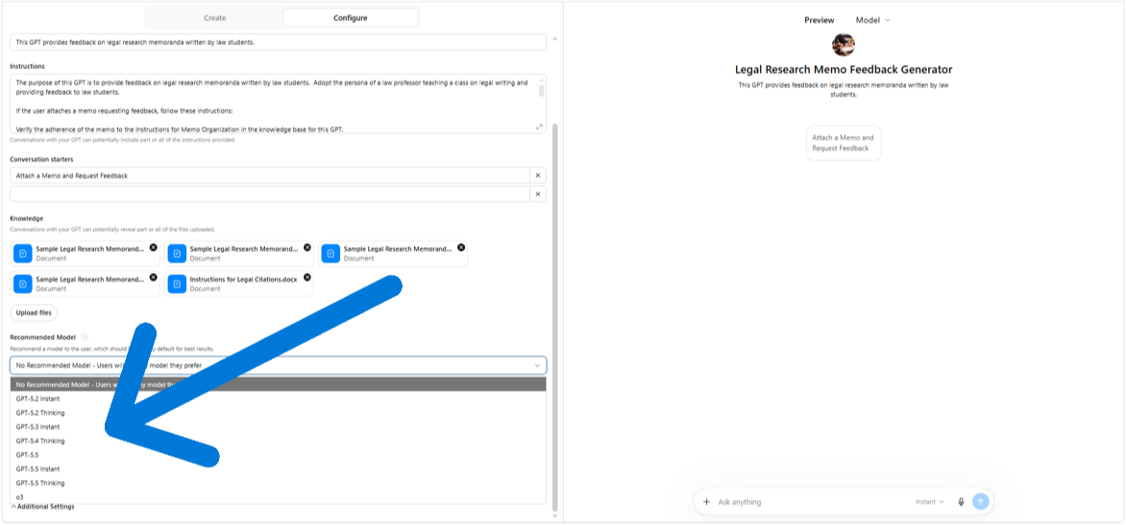

Slide 59
GPT‑5.5 Instant
Purpose: High‑speed “daily driver” for general users.
Strengths:
  Fast responses with low latency.
  52.5% fewer hallucinations vs GPT‑5.3 Instant.
  30% fewer words and lines → more concise answers.
  Real‑time self‑correction and improved factuality.
  Better at deciding when to use web search.
Use cases: Everyday Q&A, writing, summarizing, light coding, translation.
Availability: Free, Plus, Pro, Business, Enterprise.
GPT‑5.5 Thinking
Purpose: Deep reasoning for complex tasks.
Strengths:
  More deliberate multi‑step reasoning.
  Designed for logic‑heavy, research‑grade tasks.
  Better for math, analysis, planning, and long‑horizon problems.
Use cases: Research, multi‑step logic, complex coding, analytical workflows.
Availability: Plus, Team, Pro, Business, Enterprise (not Free).

Slide 60
Add Capabilities

Slide 61
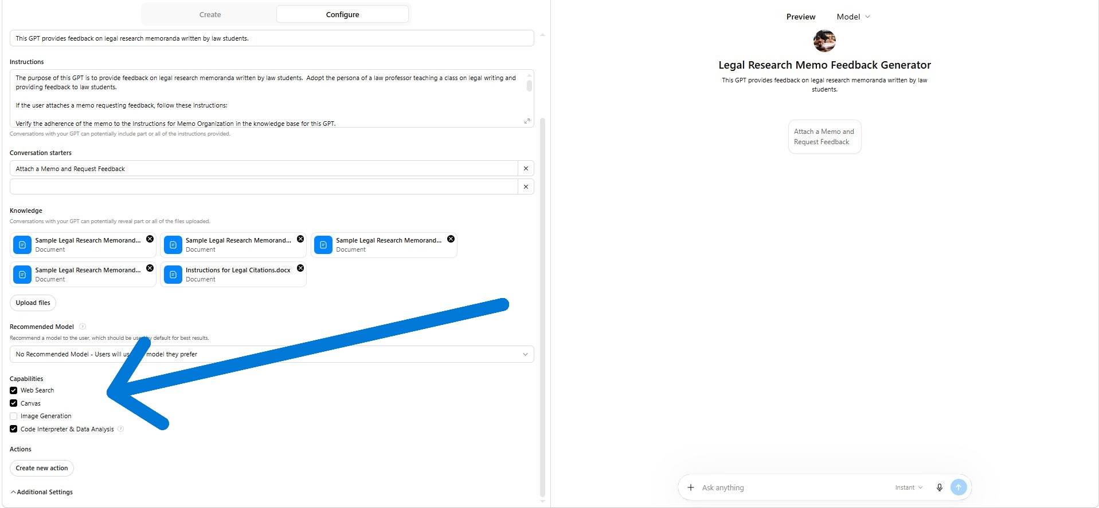

Slide 62
Web Search
Gives the GPT the ability to look up live, real-time information on the internet.
Canvas
Gives the GPT the ability to create, display, and interactively edit long-form content in a dedicated side panel (the “canvas”).

Slide 63

Image generation
Gives the Gpt the ability to
create original images based
on a text description.
Code Interpreter and Data Analysis
Gives the GPT The ability to run code (e.g., python libraries).

Slide 64
Useful Python libraries:
pyspellchecker and language_tool_python (to check spelling & Grammar)
python-docx or pdfplumber (to check document format, font)

Slide 65
Debug the GPT

Slide 66
If the gPT makes a mistake,
Ask it what instruction would rectify the issue
(Then copy and paste it into the instructions for the GPT)

Slide 67
Share the GPT

Slide 68
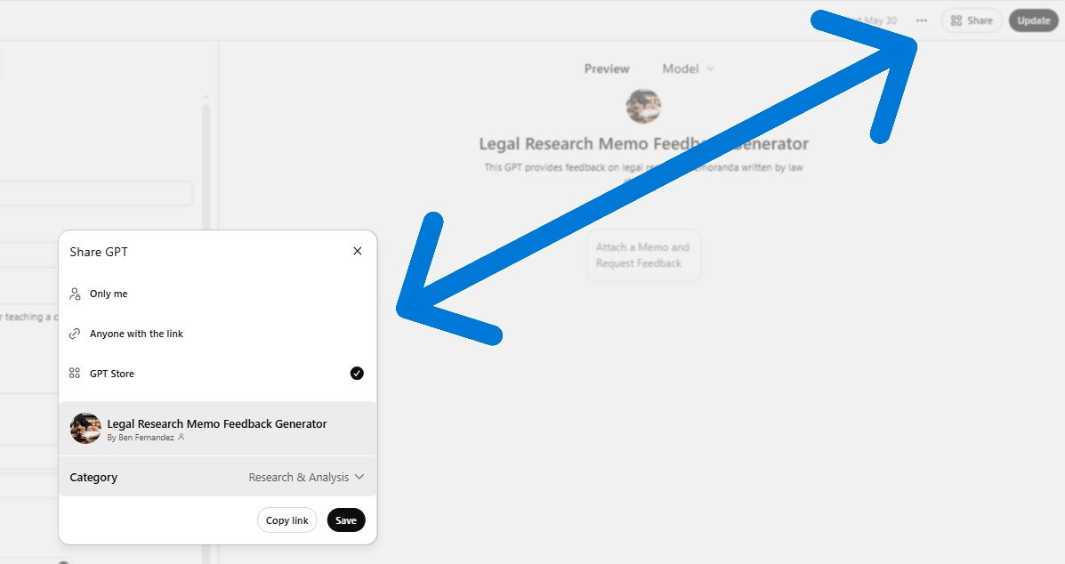

Slide 69
Edit the GPt
(Click on “Explore GPTs” in Sidebar, then click on “My GPTs”

Slide 70
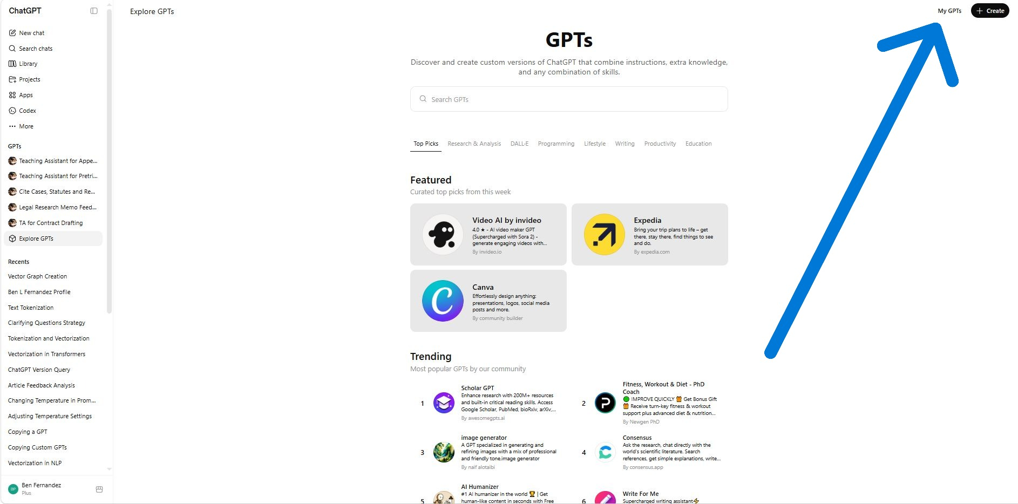

Slide 71
Click on the little pen / pencil next to the GPT you want to edit (expect to do some editing)

Slide 72
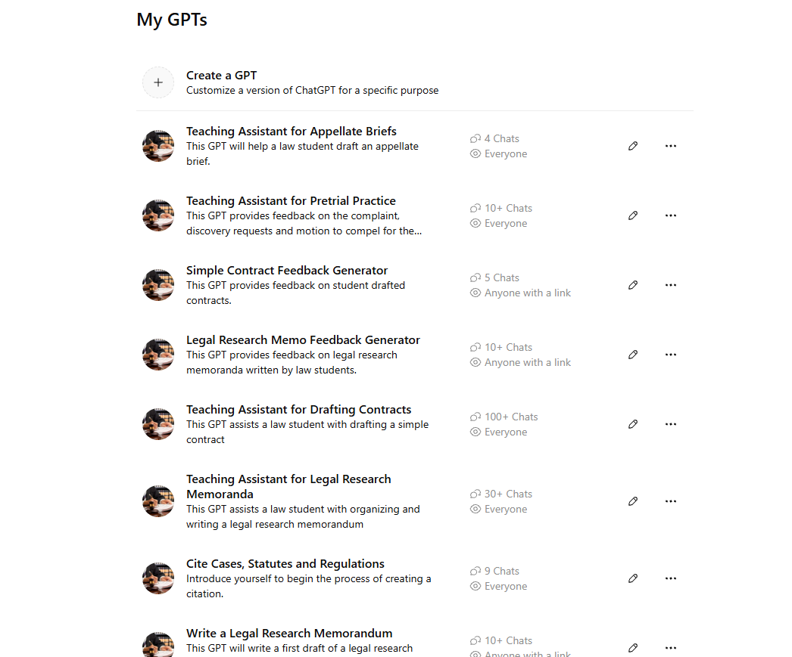

Slide 73
Types of GPT’s for Law School Classes
Feedback generator
Teaching assistant memo writer

Slide 74
Students are using GPTs for classes
To draft a contract or memo for a writing class
To draft an essay or practice multiple choice questions for a substantive class
To prepare for oral argument

Slide 75
Will textbooks come with gpts in the future?
Will there still be a need for personal GPT’s?

