Slide 1

Partnering with AI
Using AI to support feedback, student learning, and large-scale textual research
Prof. Kristin Gerdy Kyle
H. Reese Hansen Professor of Law
BYU Law School

Slide 2
Roadmap: How We Can Partner with AI
The problem: where legal teaching and scholarship are hardest to scale
Teaching example: AI-assisted feedback, prompting, and professor workflow
Student use: productive workflows, guardrails, and authorship
Scholarship example: using AI to apply a theory-driven codebook at scale
Bottom line: what AI can do well—and what faculty must still decide

Slide 3
The Problem and Part of a Solution
Legal writing feedback is intensive and individualized
Students need repeated, formative, rubric-aligned guidance
Faculty time is limited
Scholarly textual analysis is difficult to scale
AI creates new capacity, but only with structure

Slide 4
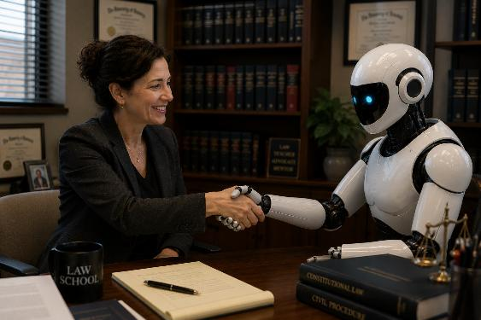
Framing the Partnership
Faculty defines the task
AI applies the framework
Faculty reviews, revises, and validates
Output becomes draft material or data, not final judgment

Slide 5
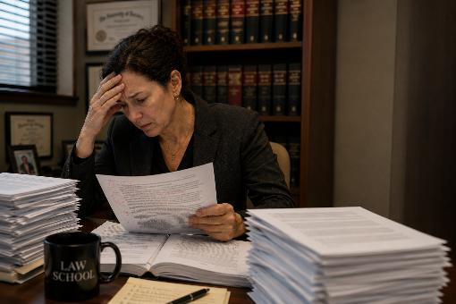
Can you relate?
Critiquing student work is
  Time consuming
  Repetitive
  Inconsistent

Slide 6
AI as a Feedback Partner: An Example
Assignment: QP for predictive memo

Slide 7
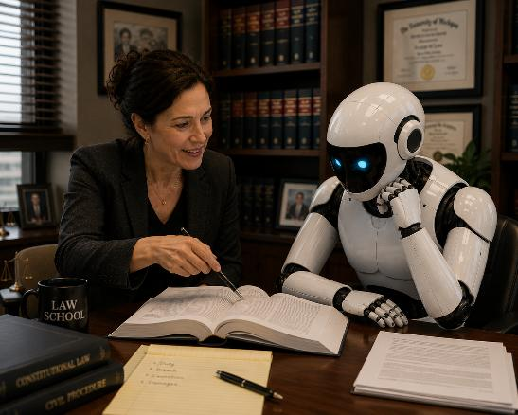
What I Gave the AI Before Student Work
Assignment instructions
Required components
Examples
Direction to give feedback based on those standards
In other words, I TAUGHT the AI about the assignment and what I was looking for

Slide 8
Crafting the Prompt: The ROADES Framework
Think of your prompt as a detailed memo to a subordinate. The more precise the memo, the better the result.
R
O
A
D
E
S
Role
Objective
Audience
Detail
Example
Style
Persona for AI
Why the task?
Who is it for?
Exact instructions
Show, don't just tell
Tone & format
Jay Adkisson, Hit the ROADES: A Lawyer's Guide to Effective AI Prompting, Forbes, February 12, 2026, https://www.forbes.com/sites/jayadkisson/2026/02/12/hit-the-roades-a-lawyers-guide-to-effective-ai-prompting/

Slide 9
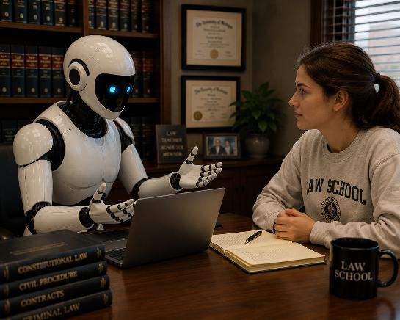
Turning Diagnosis Into Student-Facing Feedback
Student-facing feedback should be:
Encouraging
Specific
Revision-oriented
Connected to the assignment standard
Clear about next steps

Slide 10
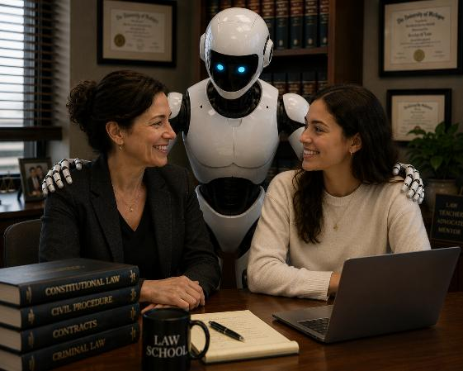
AI as a feedback partner
AI can help identify patterns in student drafts
AI can align feedback with professor-defined criteria
AI can produce consistent, formative comments
AI can translate diagnosis into student-facing language
Faculty judgment remains essential

Slide 11
ROADES Prompt for Question Presented Feedback:
Role:
You are an experienced legal writing professor assisting me in giving formative feedback to law students on Questions Presented for predictive memos.
Objective:
Evaluate each student’s Question Presented and help me generate specific, constructive, student-facing feedback. The goal is to help students write Questions Presented that introduce the governing law, accurately frame the legal issue, and incorporate the most legally significant facts.
Audience:
The feedback is for law students drafting predictive memos. The tone should be supportive, direct, and revision-oriented. The feedback should teach students how to improve the Question Presented, not merely tell them whether it is good or bad.

Slide 12
ROADES Prompt for Question Presented Feedback:
Details:
A strong Question Presented should:
  Clearly identify the legal issue before the court.
  Include the governing legal standard or doctrinal framework.
  Incorporate the key legally significant facts.
  Be specific enough to distinguish this case from other cases.
  Avoid being too abstract, too fact-heavy, or too conclusory.
  Be understandable to a reader who has not yet read the full argument.

Slide 13
ROADES Prompt for Question Presented Feedback:
Evaluate whether the Question Presented does the following:
Identifies the legal issue
Does the reader understand what legal question the court must answer?
Includes the governing law or standard
Does the QP refer to the relevant doctrine, test, statute, constitutional provision, or standard of review where appropriate?
Uses legally significant facts
Does it include the facts that matter to the legal analysis, rather than background facts or emotional facts alone?

Slide 14
ROADES Prompt for Question Presented Feedback:
Evaluate whether the Question Presented does the following:
Uses effective structure
Is the sentence or question clear, organized, and readable? Does it use the under/does/when structure?
If the student has included only legal doctrine without facts, explain that the QP needs factual context. If the student has included facts without legal framing, explain that the QP needs a clearer legal hook. If the QP is too argumentative, explain how to make it predictive.

Slide 15
ROADES Prompt for Question Presented Feedback:
Examples:
Here are examples of effective Questions Presented for this assignment:
Example 1:
Under the West Virginia burglary statute, does the State have sufficient evidence to convict a defendant of burglary when he entered another person's unoccupied tent looking for matches but instead took money from inside the tent?
Example 2:
Under the West Virginia burglary statute, does entering another person’s unoccupied tent looking for matches, and then taking money from inside, provide sufficient evidence of burglary?
Use these examples as benchmarks for the expected level of legal framing, factual specificity, and professional tone.

Slide 16
ROADES Prompt for Question Presented Feedback:
Style/Structure:
For each student submission, provide feedback in this format:
  Overall Assessment
  Briefly state the main strength and the main revision priority.
  What Is Working
  Identify specific strengths in the student’s QP.
  What Needs Revision
  Explain whether the QP needs more law, more facts, better framing, clearer structure, or a more professional tone.
  Revision Guidance
  Give concrete guidance for improving the QP.
  Possible Revised Direction
  If helpful, provide a model revision or partial revision, but preserve the student’s authorship and do not fully rewrite unless I ask.
Do not assign a grade. Do not give generic feedback. Tie every comment to the purpose of a Question Presented.

Slide 17
Student’s Draft
In West Virgina does the State have sufficient evidence to convict a man of burglary when he first plans to steal something, goes into someone else’s tent and steals money instead while there?
What should the AI notice?

Slide 18
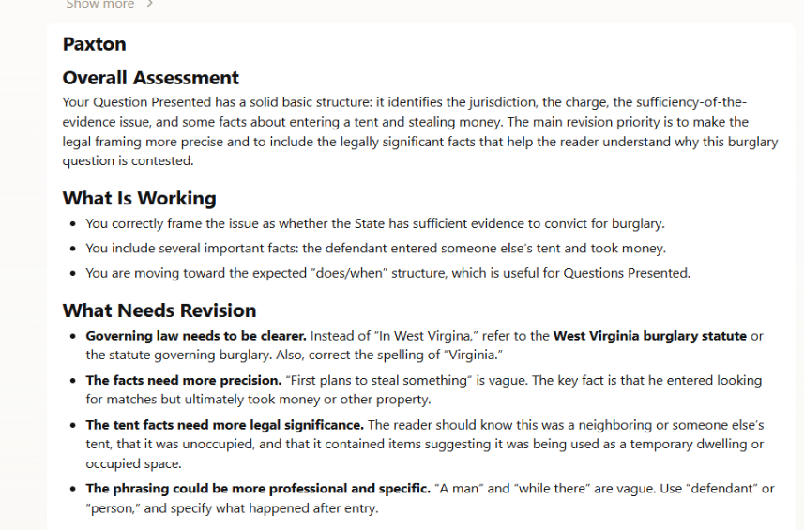
What DID the AI notice?

Slide 19
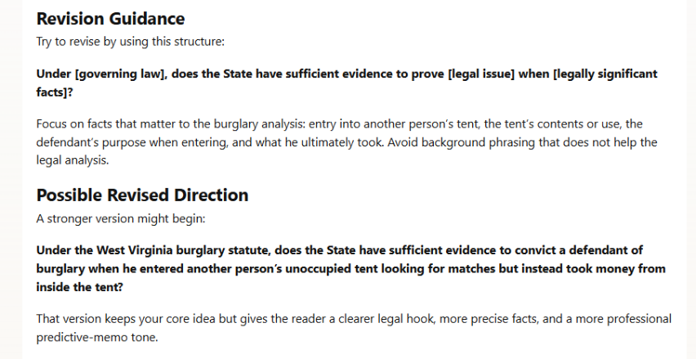
What DID the AI notice?

Slide 20
Second-Step Prompt: Convert Diagnosis to Student Feedback
Follow-up prompt:
Please rewrite this feedback directly to the student. Make it encouraging, specific, and revision-oriented. Praise what is working, explain the main issue, and give concrete next steps. Do not assign a grade. Do not rewrite the QP for the student.

Slide 21
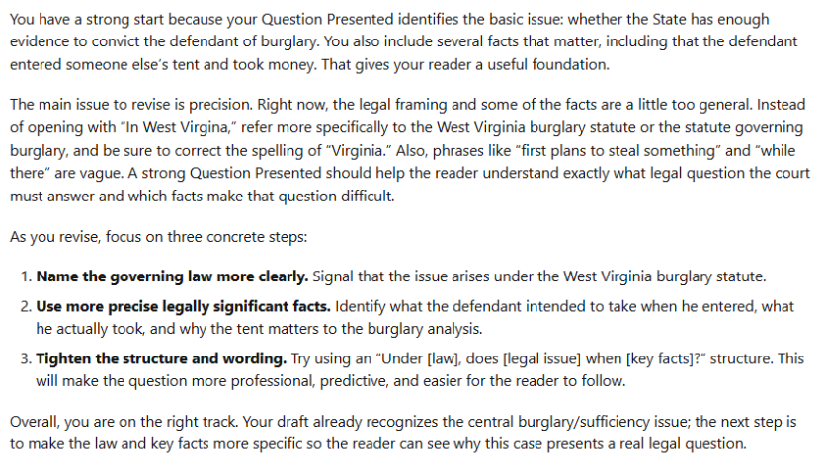
Convert Diagnosis to Student Feedback

Slide 22
Not Automated Grading—Accelerated Teaching
AI Assists; Professors Decide
Use AI to apply professor-defined criteria, surface patterns, and draft formative feedback. Faculty must review, revise, validate, and make the final judgment about accuracy, quality, and pedagogy.
AI can accelerate teaching; it cannot replace professor judgment.

Slide 23

From Prohibition to Pedagogy:
Teaching Responsible AI Use
Students will use AI in legal education and practice
The goal is disciplined, transparent, lawyerly use
AI should support:
  self-assessment
  revision
  organization
  critique
  reader testing

Slide 24
Student Workflow 1: Rubric Self-Assessment
Student prompt (notice this is essentially a ROADES prompt):
I am submitting a draft of [assignment]. Here is the rubric: [paste rubric]. Please evaluate my draft against the rubric. Identify my strongest category, my weakest category, and the top three revision priorities. Do not rewrite the draft for me.
What students learn:
How to compare draft to criteria
How to prioritize revision
How to distinguish global issues from sentence-level edits
How to take responsibility for final choices

Slide 25
Student Workflow 2: Reverse Outline and Organization Check
Student prompt:
Create a reverse outline of my draft. For each paragraph, identify the paragraph’s function, main point, and whether it advances the legal analysis. Flag any paragraphs that combine too many ideas or appear out of order.
Useful for:
Legal memoranda
Appellate briefs
Trial briefs
Seminar papers

Slide 26
Student Workflow 3: Critique, Counterargument, and Reader Testing
Student prompts:
Act as a skeptical judge. What questions would you ask?
Act as opposing counsel. What is the strongest counterargument?
Identify where my reasoning becomes conclusory. Explain my thesis in one sentence.
Tell me where a reader may get confused.

Slide 27
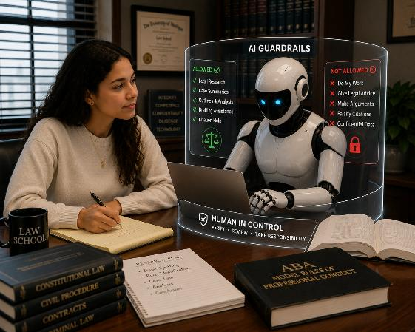
Guardrails for Student Use
Preserve authorship
Verify law, facts, and citations
Do not submit AI-generated analysis as your own
Do not enter confidential or restricted information unless permitted
Follow course disclosure rules
Keep prompts and outputs if required
Use AI to improve learning, not bypass it

Slide 28
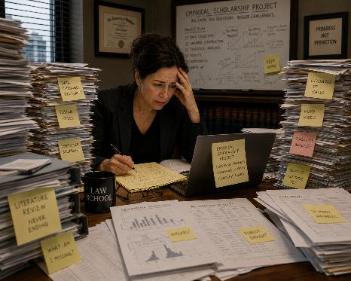
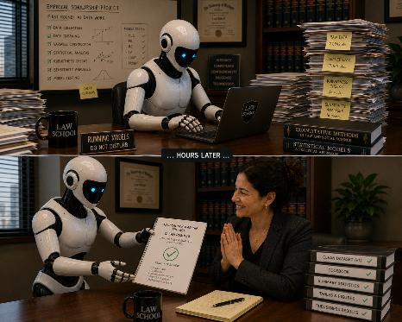
Partnering with AI in Legal Scholarship

Slide 29
The Scholarship Example: Judicial Voice
Theory-driven empirical study of judicial voice
Focus: D.C. Circuit over a forty-year comparative period
Unit of analysis: sentence-level coding
Core move: judicial persona as measurable textual variable
Four primary voice categories:
  Institutional
  Impersonal
  Collective
  Individual
Functional subcodes capture what the sentence is doing rhetorically

Slide 30
What the Study Contributes
Moves judicial persona from theory to measurable variable
Links voice choice to rhetorical function and opinion type
Extends empirical inquiry beyond the Supreme Court
Uses a forty-year D.C. Circuit framework
Treats voice patterns as proxies for rhetorical stance
Bridges qualitative rhetoric and quantitative textual analysis

Slide 31
What the Study Does—and Does Not—Measure
The study measures:
Textual voice choices
Rhetorical stance
Sentence-level function
Patterns across opinion types and time
The study does not claim to directly measure:
Judges’ interpersonal relationships
Subjective motives
Political intent
Actual collegiality or polarization

Slide 32

The Role of AI
AI became useful only after the theoretical construct had been translated into a codebook. The tool did not define judicial voice for the project. I (and scholars before me) defined judicial voice, converted that definition into sentence-level coding rules, and then I used AI to help apply those rules at scale.

Slide 33
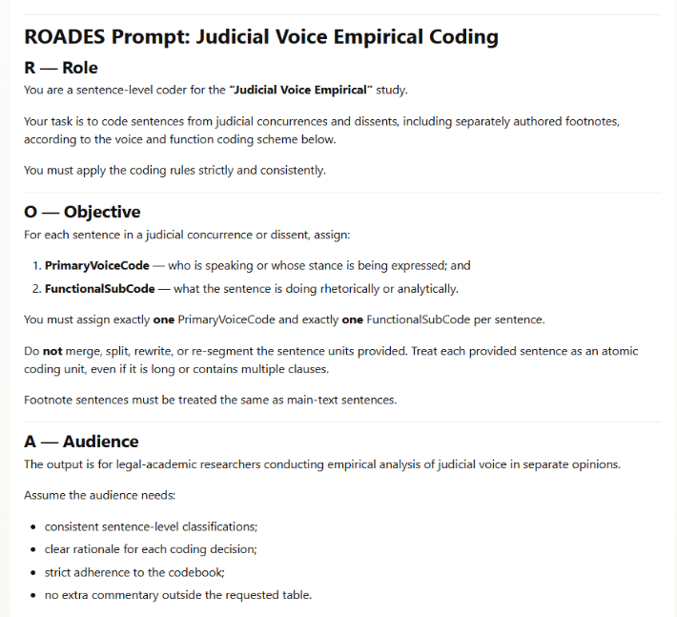
The Prompt
Some “examples,” hierarchies, and segments of the Codebook have been removed to make the prompt a bit shorter for display purposes.

Slide 34
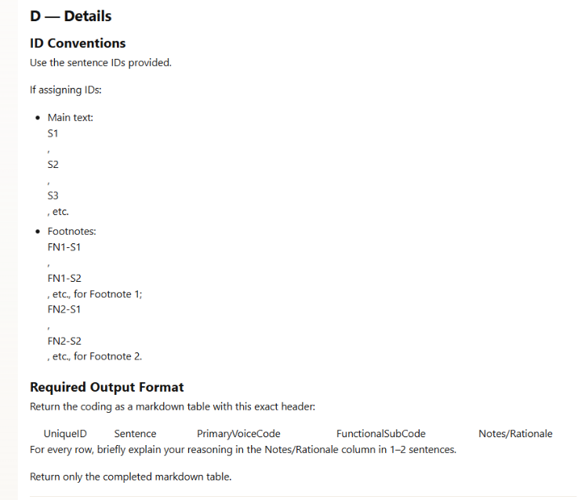
The Prompt

Slide 35
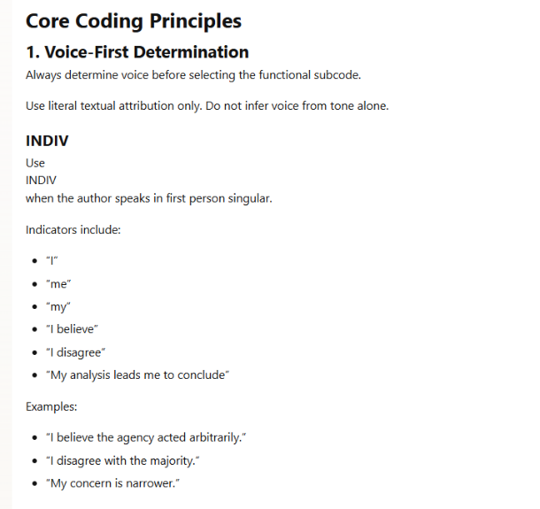
The Prompt

Slide 36
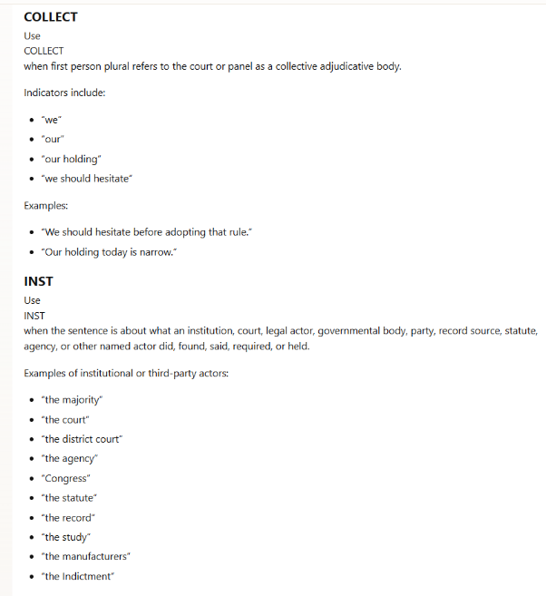
The Prompt

Slide 37
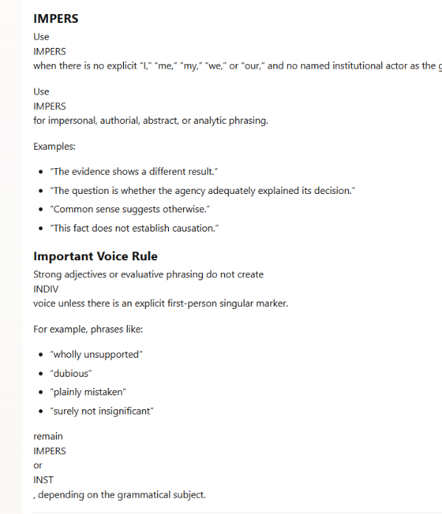
The Prompt

Slide 38
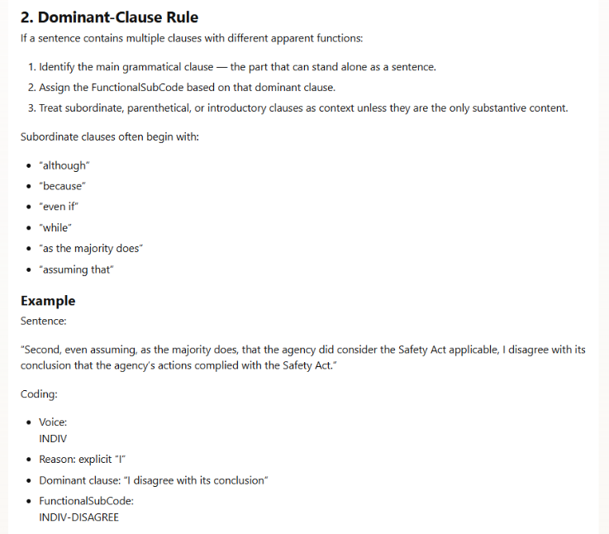
The Prompt

Slide 39
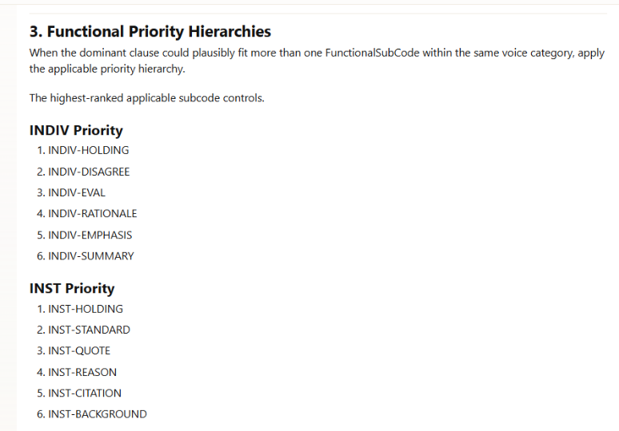
The Prompt

Slide 40
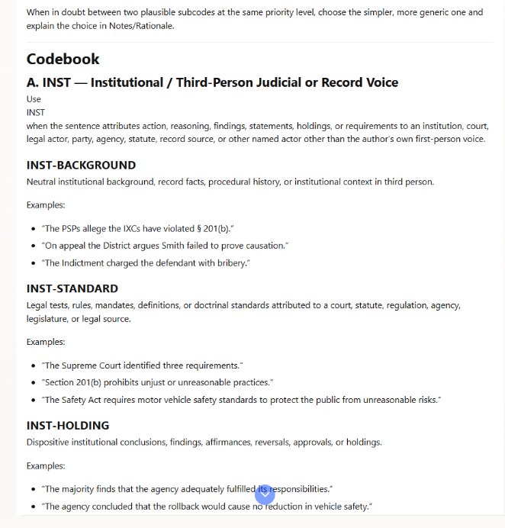
The Prompt

Slide 41
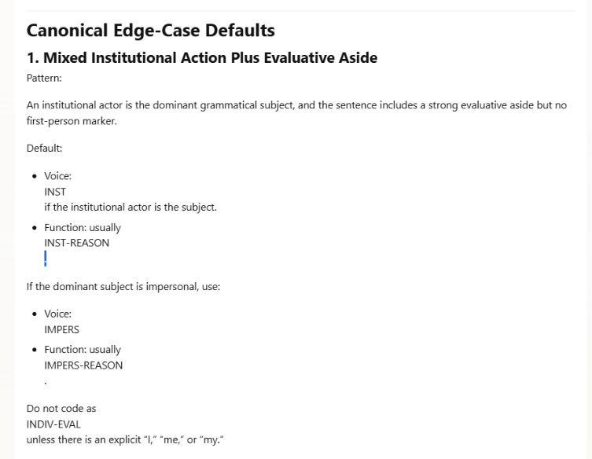
The Prompt

Slide 42
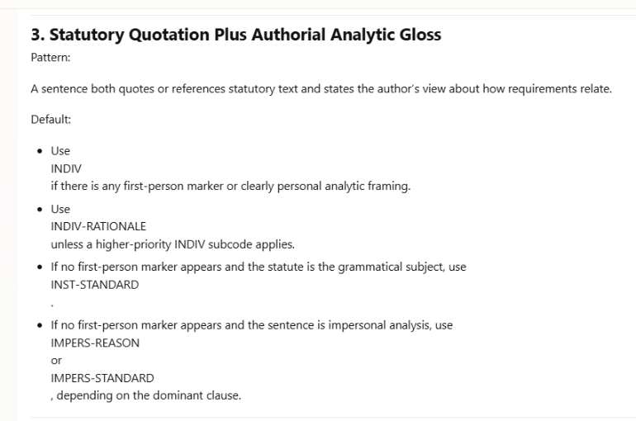
The Prompt

Slide 43
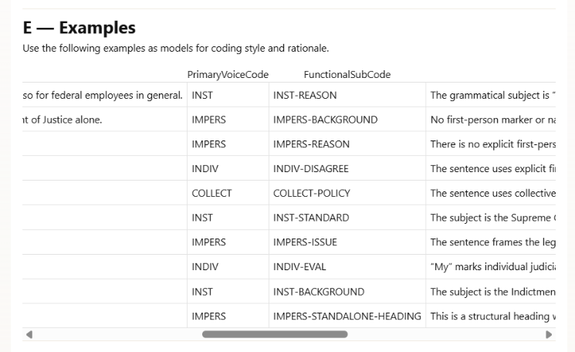
The Prompt

Slide 44
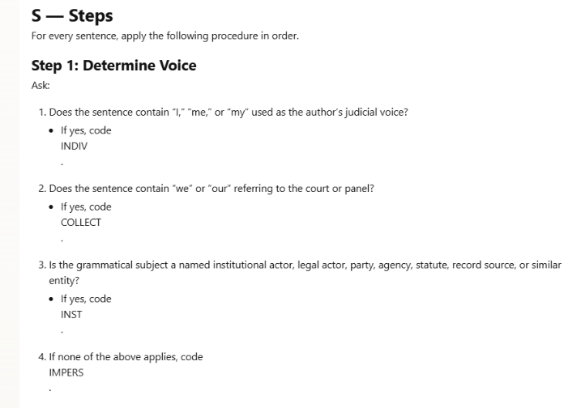
The Prompt

Slide 45
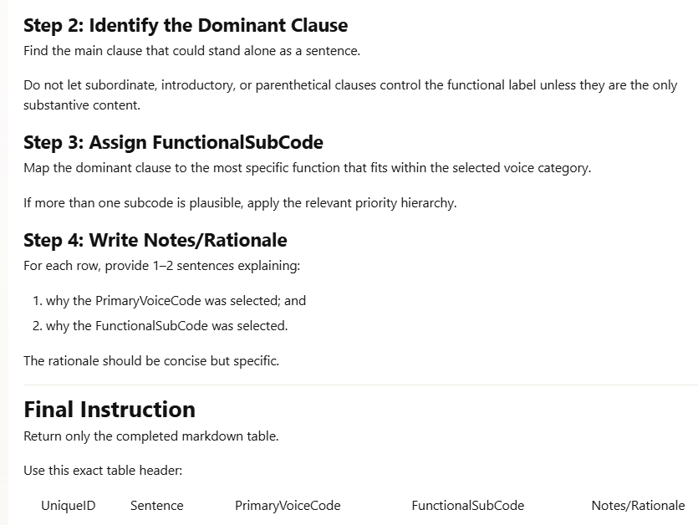
The Prompt

Slide 46
The Data Set
Judicial Voice Dataset

Slide 47
Key Takeaways
AI works best when faculty define the standards first.
Use AI to support feedback, revision, organization, and pattern recognition—not to replace professional judgment.
Better results come from structured prompts, rubrics, models, and examples.
For students, teach transparent, verified, authorship-preserving use.
In scholarship, AI is strongest when it applies a theory or codebook you have already built.
The goal is not automation for its own sake; it is accelerated teaching and scalable scholarly method with humans still in control.

